Slide 1

Cryptography and Network Security
Sixth Edition
by William Stallings
Notes:
Lecture slides prepared for “Cryptography and Network Security”, 6/e, by William Stallings, Chapter 4 – “Basic Concepts in Number Theory and Finite Fields”.

Slide 2
Chapter 4
Basic Concepts in Number Theory and Finite Fields
Notes:
Finite fields have become increasingly important in cryptography. A number of cryptographic
algorithms rely heavily on properties of finite fields, notably the Advanced
Encryption Standard (AES) and elliptic curve cryptography. Other examples include
the message authentication code CMAC and the authenticated encryption
scheme GCM.
This chapter provides the reader with sufficient background on the concepts of
finite fields to be able to understand the design of AES and other cryptographic algorithms
that use finite fields. The first three sections introduce basic concepts from number
theory that are needed in the remainder of the chapter; these include divisibility,
the Euclidian algorithm, and modular arithmetic. Next comes a brief overview of the
concepts of group, ring, and field. This section is somewhat abstract; the reader may
prefer to quickly skim this section on a first reading. We are then ready to discuss finite
fields of the form GF(p ), where p is a prime number. Next, we need some additional
background, this time in polynomial arithmetic. The chapter concludes with a discussion
of finite fields of the form GF(2^{n} ), where n is a positive integer.

Slide 3
“Mathematics has long been known in the printing trade as difficult, or penalty, copy because it is slower, more difficult, and more expensive to set in type than any other kind of copy.”
—Chicago Manual of Style,
14th Edition
Notes:
The concepts and techniques of number theory are quite abstract, and it is
often difficult to grasp them intuitively without examples. Accordingly, this chapter
and Chapter 8 include a number of examples, each of which is highlighted in a
shaded box.

Slide 4
Divisibility
We say that a nonzero b divides a if a = mb for some m, where a, b, and m are integers
b divides a if there is no remainder on division
The notation b | a is commonly used to mean b divides a
If b | a we say that b is a divisor of a
The positive divisors of 24 are 1, 2, 3, 4, 6, 8, 12, and 24
13 | 182; - 5 | 30; 17 | 289; - 3 | 33; 17 | 0
Notes:
We say that a nonzero b divides a if a=mb for some m, where a, b, and m are integers. That is, b divides a if there is no remainder on division.
The notation b | a is commonly used to mean b divides a . Also, if b | a , we say that b is a divisor of a .

Slide 5
Properties of Divisibility
If a | 1, then a = ±1
If a | b and b | a, then a = ±b
Any b ≠ 0 divides 0
If a | b and b | c, then a | c
If b | g and b | h, then b | (mg + nh) for arbitrary integers m and n
11 | 66 and 66 | 198 = 11 | 198
Notes:
Subsequently, we will need some simple properties of divisibility for integers, which are as follows:
• If a|1, then a = ±1.
• If a|b and b|a, then a = ±b.
• Any b ≠ 0 divides 0.
• If a | b and b | c, then a | c
• If b|g and b|h, then b|(mg + nh) for arbitrary integers m and n.

Slide 6
Properties of Divisibility
To see this last point, note that:
  If b | g , then g is of the form g = b * g₁ for some integer g₁
  If b | h , then h is of the form h = b * h₁ for some integer h₁
So:
  mg + nh = mbg₁ + nbh₁ = b * (mg₁ + nh₁ )
  and therefore b divides mg + nh
b = 7; g = 14; h = 63; m = 3; n = 2
7 | 14 and 7 | 63.
To show 7 (3 * 14 + 2 * 63),
we have (3 * 14 + 2 * 63) = 7(3 * 2 + 2 * 9),
and it is obvious that 7 | (7(3 * 2 + 2 * 9)).
Notes:
To see this last point, note that
• If b | g , then g is of the form g = b * g₁ for some integer g₁ .
• If b | h , then h is of the form h = b * h₁ for some integer h₁ .
So
mg + nh = mbg₁ + nbh₁ = b * (mg₁ + nh₁ )
and therefore b divides mg + nh .

Slide 7
Division Algorithm
Given any positive integer n and any nonnegative integer a, if we divide a by n we get an integer quotient q and an integer remainder r that obey the following relationship:
  a = qn + r 0 ≤ r < n; q = [a/n]
Notes:
Given any positive integer n and any nonnegative integer a, if we divide a by n, we get an integer quotient q and an integer remainder r that obey the following relationship:
a = qn + r, 0 ≤ r < n; q = [a/n] which is referred to as the division algorithm.

Slide 8
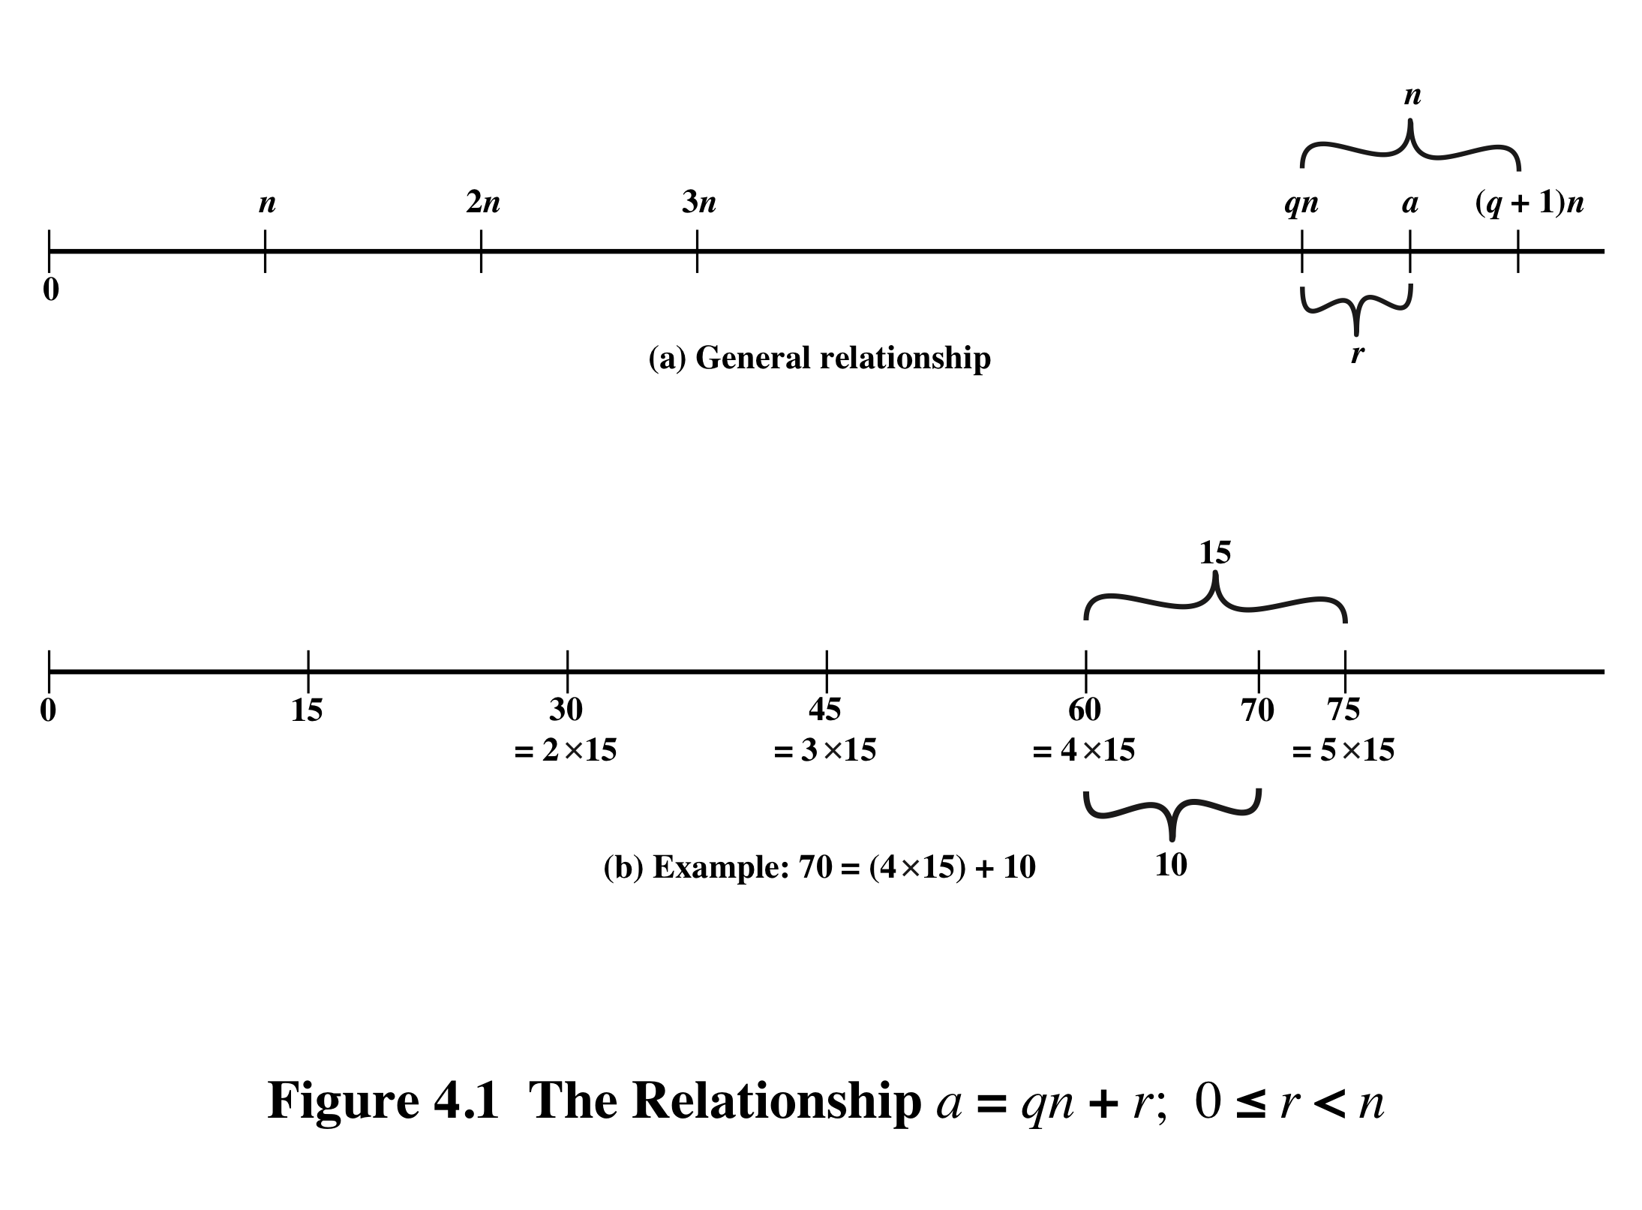
Notes:
Figure 4.1a demonstrates that, given a and positive n, it is always possible to find q and r that satisfy the preceding relationship. Represent the integers on the number line; a will fall somewhere on that line (positive a is shown, a similar demonstration can be made for negative a). Starting at 0, proceed to n, 2n, up to qn such that qn ≤ a and (q + 1)n > a. The distance from qn to a is r, and we have found the unique values of q and r. The remainder r is often referred to as a residue .
For example:
a = 11; n = 7; 11 = 1 x 7 + 4; r = 4 q = 1
a = –11; n = 7; –11 = (–2) x 7 + 3; r = 3 q = –2
Figure 4.1b provides another example.

Slide 9
Euclidean Algorithm
One of the basic techniques of number theory
Procedure for determining the greatest common divisor of two positive integers
Two integers are relatively prime if their only common positive integer factor is 1
Notes:
One of the basic techniques of number theory is the Euclidean algorithm, which
is a simple procedure for determining the greatest common divisor of two positive
integers. First, we need a simple definition: Two integers are relatively prime if their
only common positive integer factor is 1.

Slide 10
Greatest Common Divisor (GCD)
The greatest common divisor of a and b is the largest integer that divides both a and b
We can use the notation gcd(a,b) to mean the greatest common divisor of a and b
We also define gcd(0,0) = 0
Positive integer c is said to be the gcd of a and b if:
  c is a divisor of a and b
  Any divisor of a and b is a divisor of c
  An equivalent definition is:
  gcd(a,b) = max[k, such that k | a and k | b]
Notes:
Recall that nonzero b is defined to be a divisor of a if a = mb for some m , where a , b , and
m are integers. We will use the notation gcd(a , b ) to mean the greatest common divisor
of a and b . The greatest common divisor of a and b is the largest integer that divides
both a and b . We also define gcd(0, 0) = 0.
More formally, the positive integer c is said to be the greatest common divisor
of a and b if
1. c is a divisor of a and of b .
2. Any divisor of a and b is a divisor of c .
An equivalent definition is the following:
gcd(a , b ) = max[k , such that k | a and k | b ]

Slide 11
GCD
Because we require that the greatest common divisor be positive, gcd(a,b) = gcd(a,-b) = gcd(-a,b) = gcd(-a,-b)
In general, gcd(a,b) = gcd(| a |, | b |)
Also, because all nonzero integers divide 0, we have gcd(a,0) = | a |
We stated that two integers a and b are relatively prime if their only common positive integer factor is 1; this is equivalent to saying that a and b are relatively prime if gcd(a,b) = 1
gcd(60, 24) = gcd(60, - 24) = 12
8 and 15 are relatively prime because the positive divisors of 8 are 1, 2, 4, and 8, and the positive divisors of 15 are 1, 3, 5, and 15. So 1 is the only integer on both lists.
Notes:
Because we require that the greatest common divisor be positive, gcd(a , b ) =
gcd(a , -b ) = gcd(-a , b ) = gcd(-a ,-b ). In general, gcd(a , b ) = gcd( | a | , | b | ).
Also, because all nonzero integers divide 0, we have gcd(a , 0) = a .
We stated that two integers a and b are relatively prime if their only common
positive integer factor is 1. This is equivalent to saying that a and b are relatively
prime if gcd(a , b ) = 1.

Slide 12
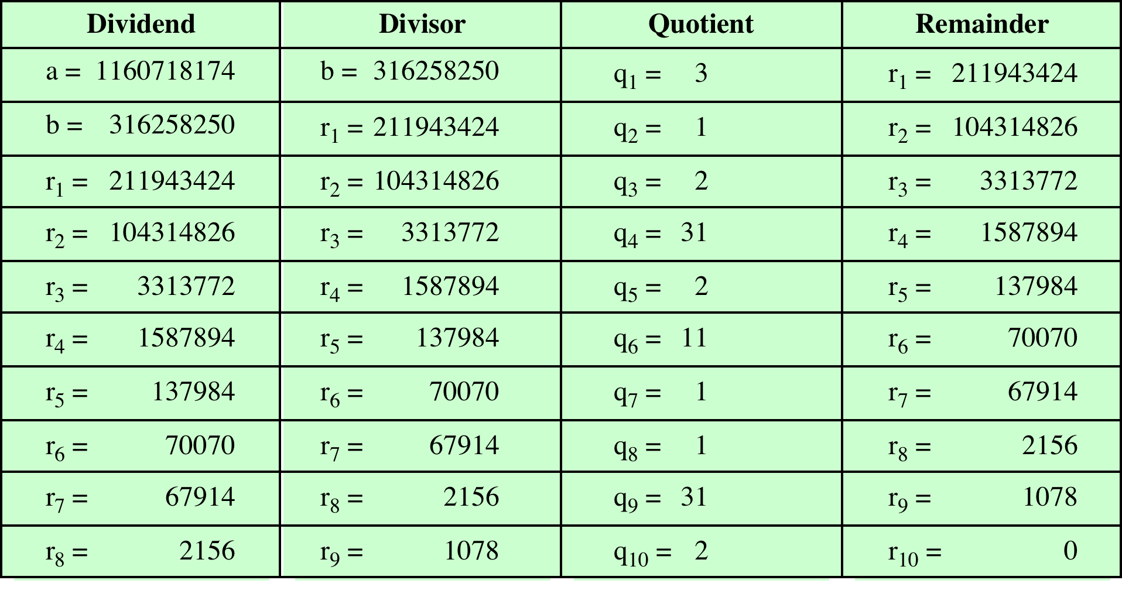
Table 4.1
Euclidean Algorithm Example
(This table can be found on page 91 in the textbook)
Notes:
In this example, we begin by dividing 1160718174 by 316258250, which gives 3
with a remainder of 211943424. Next we take 316258250 and divide it by 211943424.
The process continues until we get a remainder of 0, yielding a result of 1078.

Slide 13
Modular Arithmetic
The modulus
  If a is an integer and n is a positive integer, we define a mod n to be the remainder when a is divided by n; the integer n is called the modulus
  thus, for any integer a:
  a = qn + r 0 ≤ r < n; q = [a/ n]
  a = [a/ n] * n + ( a mod n)
11 mod 7 = 4; - 11 mod 7 = 3
Notes:
If a is an integer and n is a positive integer, we define a mod n to be the remainder
when a is divided by n . The integer n is called the modulus . Thus, for any integer a:
a = qn + r 0 ≤ r < n; q = [ a/ n]
a = [a/ n] * n + ( a mod n)

Slide 14
Modular Arithmetic
Congruent modulo n
  Two integers a and b are said to be congruent modulo n if (a mod n) = (b mod n)
  This is written as a = b(mod n)²
  Note that if a = 0(mod n), then n | a
73 = 4 (mod 23); 21 = - 9 (mod 10)
Notes:
Two integers a and b are said to be congruent modulo n , if (a mod n ) =
(b mod n ). This is written as a K b (mod n ).²
Note that if a = 0 (mod n ), then n | a .

Slide 15
Properties of Congruences
Congruences have the following properties:
1. a = b (mod n) if n (a – b)
2. a = b (mod n) implies b = a (mod n)
3. a = b (mod n) and b = c (mod n) imply a = c (mod n)
To demonstrate the first point, if n (a - b), then (a - b) = kn for some k
  So we can write a = b + kn
  Therefore, (a mod n) = (remainder when b + kn is divided by n) = (remainder when b is divided by n) = (b mod n)
23 = 8 (mod 5) because 23 - 8 = 15 = 5 * 3
- 11 = 5 (mod 8) because - 11 - 5 = - 16 = 8 * (- 2)
81 = 0 (mod 27) because 81 - 0 = 81 = 27 * 3
Notes:
Congruences have the following properties:
1. a = b (mod n) if n (a – b)
2. a = b (mod n) implies b = a (mod n)
3. a = b (mod n) and b = c (mod n) imply a = c (mod n)
To demonstrate the first point, if n (a - b), then (a - b) = kn for some k
So we can write a = b + kn
Therefore, (a mod n) = (remainder when b + kn is divided by n) = (remainder when b is divided by n) = (b mod n)

Slide 16
Modular Arithmetic
Modular arithmetic exhibits the following properties:
1. [(a mod n) + (b mod n)] mod n = (a + b) mod n
2. [(a mod n) - (b mod n)] mod n = (a - b) mod n
3. [(a mod n) * (b mod n)] mod n = (a * b) mod n
We demonstrate the first property:
  Define (a mod n) = r_{a} and (b mod n) = r_{b}. Then we can write a = r_{a} + jn for some integer j and b = r_{b} + kn for some integer k
  Then:
(a + b) mod n = (r_{a} + jn + r_{b} + kn) mod n
= (r_{a} + r_{b} + (k + j)n) mod n
= (r_{a} + r_{b}) mod n
= [(a mod n) + (b mod n)] mod n
Notes:
Modular arithmetic exhibits the following properties:
1. [(a mod n) + (b mod n)] mod n = (a + b) mod n
2. [(a mod n) - (b mod n)] mod n = (a - b) mod n
3. [(a mod n) * (b mod n)] mod n = (a * b) mod n
We demonstrate the first property:
Define (a mod n) = r_{a} and (b mod n) = r_{b}. Then we can write a = r_{a} + jn for some integer j and b = r_{b} + kn for some integer k.
Then:
(a + b) mod n = (ra + jn + rb + kn) mod n
= (ra + rb + (k + j)n) mod n
= (ra + rb) mod n
= [(a mod n) + (b mod n)] mod n

Slide 17
Remaining Properties:
Examples of the three remaining properties:
11 mod 8 = 3; 15 mod 8 = 7
[(11 mod 8) + (15 mod 8)] mod 8 = 10 mod 8 = 2
(11 + 15) mod 8 = 26 mod 8 = 2
[(11 mod 8) - (15 mod 8)] mod 8 = - 4 mod 8 = 4
(11 - 15) mod 8 = - 4 mod 8 = 4
[(11 mod 8) * (15 mod 8)] mod 8 = 21 mod 8 = 5
(11 * 15) mod 8 = 165 mod 8 = 5
Notes:
The remaining properties are proven as easily. Here are examples of the three
Properties.

Slide 18
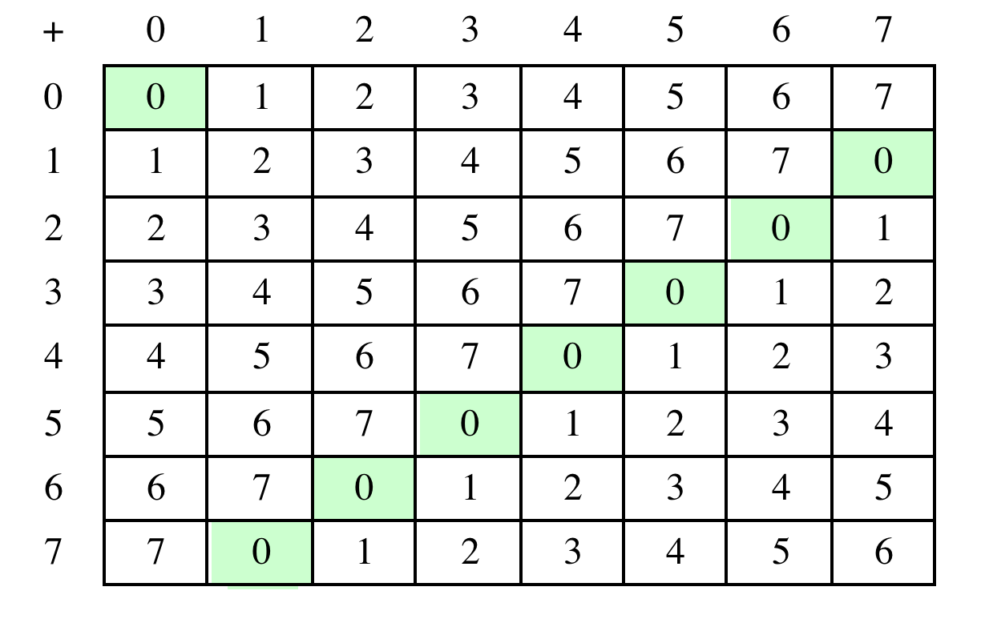
Table 4.2(a) Arithmetic Modulo 8
Notes:
Table 4.2 provides an illustration of modular addition and multiplication
modulo 8. Looking at addition, the results are straightforward, and there is a regular
pattern to the matrix. Both matrices are symmetric about the main diagonal
in conformance to the commutative property of addition and multiplication.

Slide 19
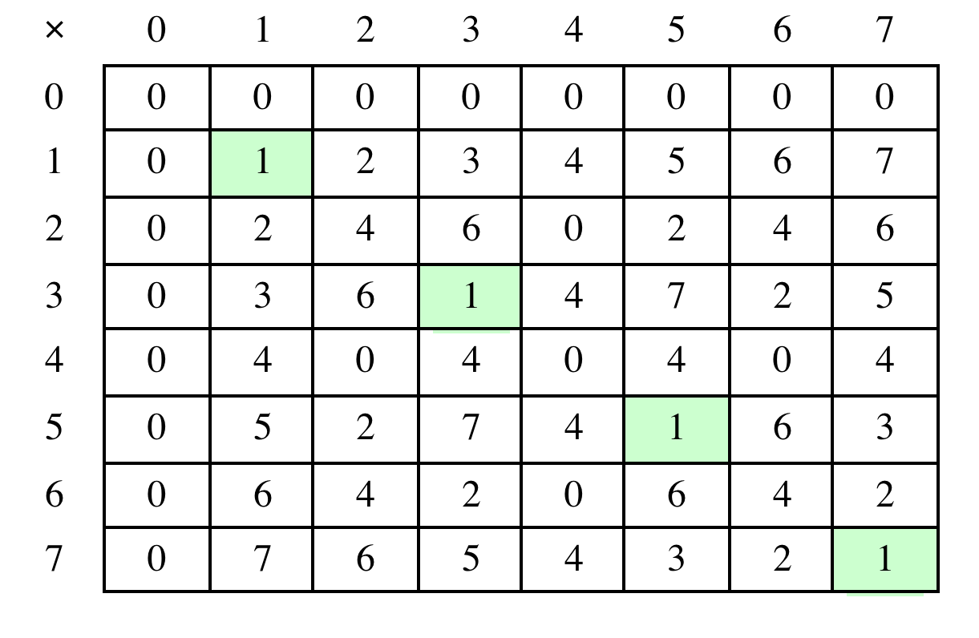
Table 4.2(b) Multiplication Modulo 8
Notes:
Similarly, the entries in the multiplication table are straightforward. In ordinary
arithmetic, there is a multiplicative inverse, or reciprocal, to each integer. In modular
arithmetic mod 8, the multiplicative inverse of x is the integer y such that
(x * y ) mod 8 = 1 mod 8. Now, to find the multiplicative inverse of an integer
from the multiplication table, scan across the matrix in the row for that integer to
find the value 1; the integer at the top of that column is the multiplicative inverse;
thus, (3 * 3) mod 8 = 1. Note that not all integers mod 8 have a multiplicative
inverse; more about that later.

Slide 20
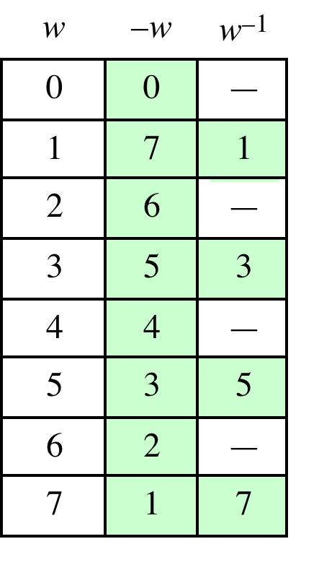
Table 4.2(c)
Additive and
Multiplicative Inverses
Modulo 8
Notes:
As in ordinary addition, there is an additive inverse, or negative, to each integer in
modular arithmetic. In this case, the negative of an integer x is the integer y such
that (x + y ) mod 8 = 0. To find the additive inverse of an integer in the left-hand
column, scan across the corresponding row of the matrix to find the value 0; the
integer at the top of that column is the additive inverse; thus, (2 + 6) mod 8 = 0.

Slide 21
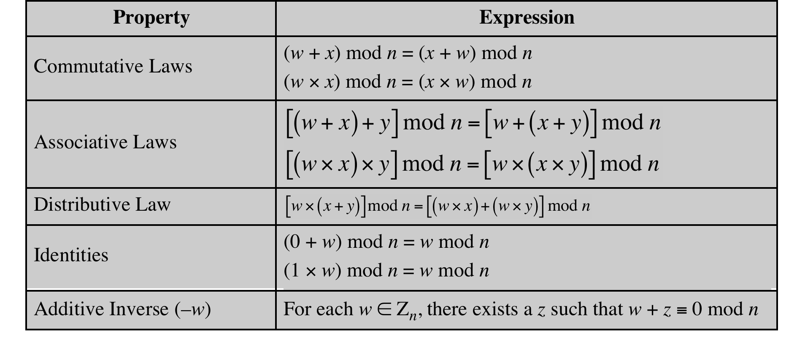
Table 4.3
Properties of Modular Arithmetic for Integers in Z_{n}
Notes:
If we perform modular arithmetic within Z_{n}, the properties shown in Table 4.3 hold for integers in Z_{n} We show in the next section that this implies that Z_{n} is a commutative ring with a multiplicative identity element. Note that unlike ordinary arithmetic, the following statement is true only with the attached condition:
if (a x b) = (a x c) (mod n) then b = c (mod n) if a is relatively prime to n
In general, an integer has a multiplicative inverse in Z_{n} if that integer is relatively prime to n. Table 4.2 cin the text shows that the integers 1, 3, 5, and 7 have a multiplicative inverse in Z 8, but 2, 4, and 6 do not.

Slide 22
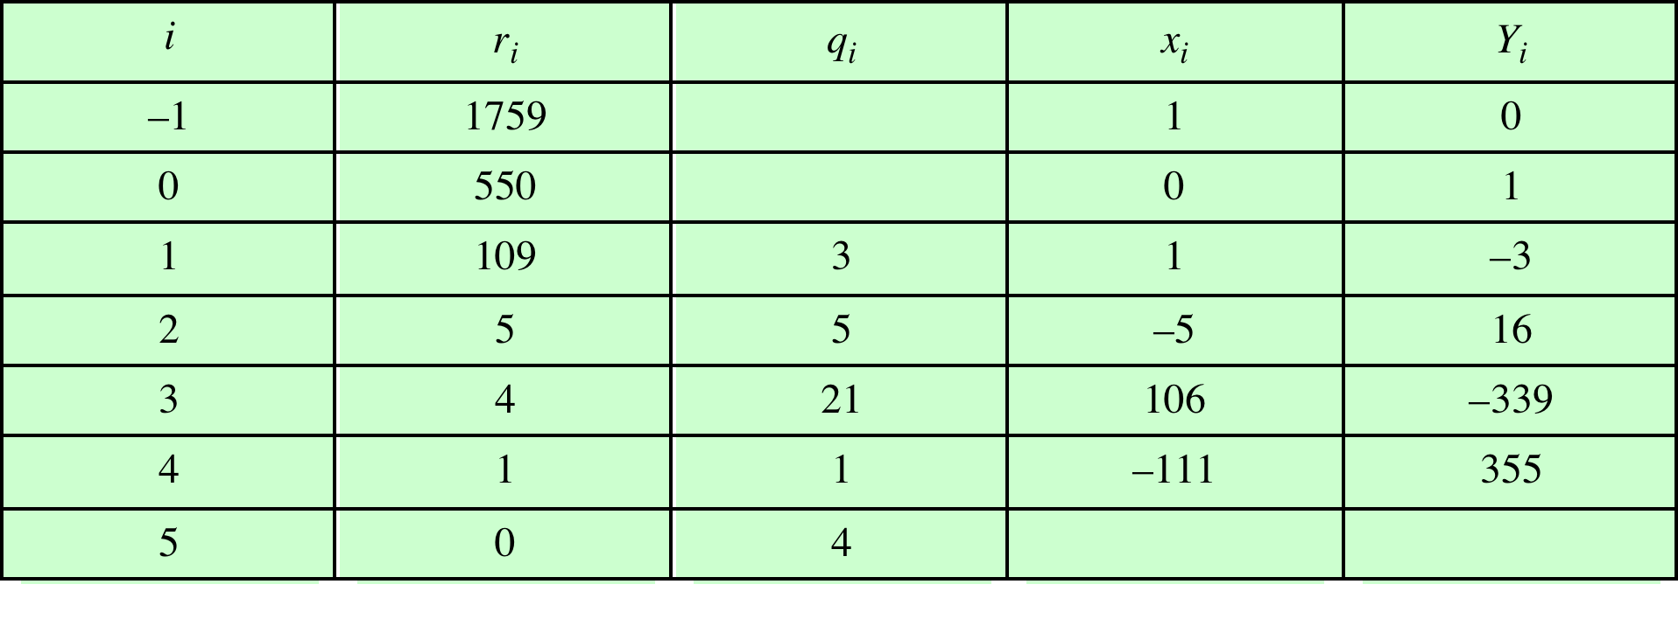
Table 4.4
Extended Euclidean Algorithm Example
For given integers a and b, find <d,x,y> satisfying: ax + by = d = gcd(a,b)
a
b
Result: d = 1; x = –111; y = 355
Notes:
Example of the Extended Euclidean Algorithm. (See pages 97 – 99 in textbook for details.)

Slide 23
Groups
A set of elements with a binary operation denoted by • that associates to each ordered pair (a,b) of elements in G an element (a • b ) in G , such that the following axioms are obeyed:
  (A1) Closure:
    If a and b belong to G, then a • b is also in G
  (A2) Associative:
    a • (b • c) = (a • b) • c for all a, b, c in G
  (A3) Identity element:
    There is an element e in G such that a • e = e • a = a for all a in G
  (A4) Inverse element:
    For each a in G, there is an element a in G such that a•a = a • a = e
  (A5) Commutative:
    a • b = b • a for all a, b in G
Notes:
Groups, rings, and fields are the fundamental elements of a branch of mathematics
known as abstract algebra, or modern algebra. In abstract algebra, we are concerned
with sets on whose elements we can operate algebraically; that is, we can combine
two elements of the set, perhaps in several ways, to obtain a third element of the set.
These operations are subject to specific rules, which define the nature of the set. By
convention, the notation for the two principal classes of operations
on set elements is usually the same as the notation for addition and multiplication on ordinary numbers.
However, it is important to note that, in abstract algebra, we are not limited to
ordinary arithmetical operations. All this should become clear as we proceed.
A group G , sometimes denoted by {G , * }, is a set of elements with a binary operation
denoted by * that associates to each ordered pair (a, b ) of elements in G an element
(a ~ b ) in G , such that the following axioms are obeyed:
(A1) Closure:
If a and b belong to G, then a * b is also in G
(A2) Associative:
a * (b * c) = (a * b) * c for all a, b, c in G
(A3) Identity element:
There is an element e in G such that a * e = e * a = a for all a in G
(A4) Inverse element:
For each a in G, there is an element a in G such that a*a = a * a = e
(A5) Commutative:
a * b = b * a for all a, b in G

Slide 24
Cyclic Group
Exponentiation is defined within a group as a repeated application of the group operator, so that a³ = a•a•a
We define a⁰ = e as the identity element, and a^{-n} = (a’)^{n} , where a’ is the inverse element of a within the group
A group G is cyclic if every element of G is a power a^{k} (k is an integer) of a fixed element
  The element a is said to generate the group G or to be a generator of G
  A cyclic group is always abelian and may be finite or infinite
Notes:
Define exponentiation in a group as the repeated use of the group operator. Note that we are most familiar with it being applied to multiplication, but it is more general than that. If the repeated use of the operator on some value a in the group results in every possible value being created, then the group is said to be cyclic, and a is a generator of (or generates) the group G.

Slide 25
Rings
A ring R , sometimes denoted by {R , + , * }, is a set of elements with two binary operations, called addition and multiplication, such that for all a , b , c in R the following axioms are obeyed:
(A1–A5)
  R is an abelian group with respect to addition; that is, R satisfies axioms A1 through A5. For the case of an additive group, we denote the identity element as 0 and the inverse of a as –a
  (M1) Closure under multiplication:
  If a and b belong to R , then ab is also in R
(M2) Associativity of multiplication:
a (bc ) = (ab)c for all a , b , c in R
(M3) Distributive laws:
a (b + c ) = ab + ac for all a , b , c in R
  (a + b )c = ac + bc for all a , b , c in R
In essence, a ring is a set in which we can do addition, subtraction [a - b = a + (-b )], and multiplication without leaving the set
Notes:
A ring R , sometimes denoted by {R , + , * }, is a set of elements with two binary operations, called addition and multiplication, such that for all a , b , c in R the following axioms are obeyed:
(A1–A5)
R is an abelian group with respect to addition; that is, R satisfies axioms A1 through A5. For the case of an additive group, we denote the identity element as 0 and the inverse of a as –a
(M1) Closure under multiplication:
If a and b belong to R , then ab is also in R
(M2) Associativity of multiplication:
a (bc ) = (ab)c for all a , b , c in R
(M3) Distributive laws:
a (b + c ) = ab + ac for all a , b , c in R
(a + b )c = ac + bc for all a , b , c in R
In essence, a ring is a set in which we can do addition, subtraction [a - b = a + (-b )], and multiplication without leaving the set

Slide 26
Rings (cont.)
A ring is said to be commutative if it satisfies the following additional condition:
(M4) Commutativity of multiplication:
ab = ba for all a, b in R
An integral domain is a commutative ring that obeys the following axioms.
(M5) Multiplicative identity:
There is an element 1 in R such that a 1 = 1a = a for all a in R
(M6) No zero divisors:
If a , b in R and ab = 0, then either a = 0 or b = 0
Notes:
A ring is said to be commutative if it satisfies the following additional condition:
(M4) Commutativity of multiplication:
ab = ba for all a, b in R
An integral domain is a commutative ring that obeys the following axioms.
(M5) Multiplicative identity:
There is an element 1 in R such that a 1 = 1a = a for all a in R
(M6) No zero divisors:
If a , b in R and ab = 0, then either a = 0 or b = 0

Slide 27
Fields
A field F , sometimes denoted by {F, +,* }, is a set of elements with two binary operations, called addition and multiplication, such that for all a, b, c in F the following axioms are obeyed:
(A1–M6)
F is an integral domain; that is, F satisfies axioms A1 through A5 and M1
through M6
(M7) Multiplicative inverse:
For each a in F, except 0, there is an element a⁻¹ in F such that aa⁻¹ = (a⁻¹ )a = 1
In essence, a field is a set in which we can do addition, subtraction, multiplication, and division without leaving the set. Division is defined with the following rule: a /b = a (b⁻¹ )
Familiar examples of fields are the rational numbers, the real numbers, and the complex numbers. Note that the set of all integers is not a field, because not every element of the set has a multiplicative inverse.
Notes:
A field F , sometimes denoted by {F , + , * }, is a set of elements with two binary operations,
called addition and multiplication , such that for all a , b , c in F the following
axioms are obeyed.
(A1–M6) F is an integral domain; that is, F satisfies axioms A1 through A5 and
M1 through M6.
(M7) Multiplicative inverse: For each a in F , except 0, there is an element
a⁻¹ in F such that aa⁻¹ = (a⁻¹ )a = 1.
In essence, a field is a set in which we can do addition, subtraction, multiplication,
and division without leaving the set. Division is defined with the following rule:a /b = a (b⁻¹ ).

Slide 28
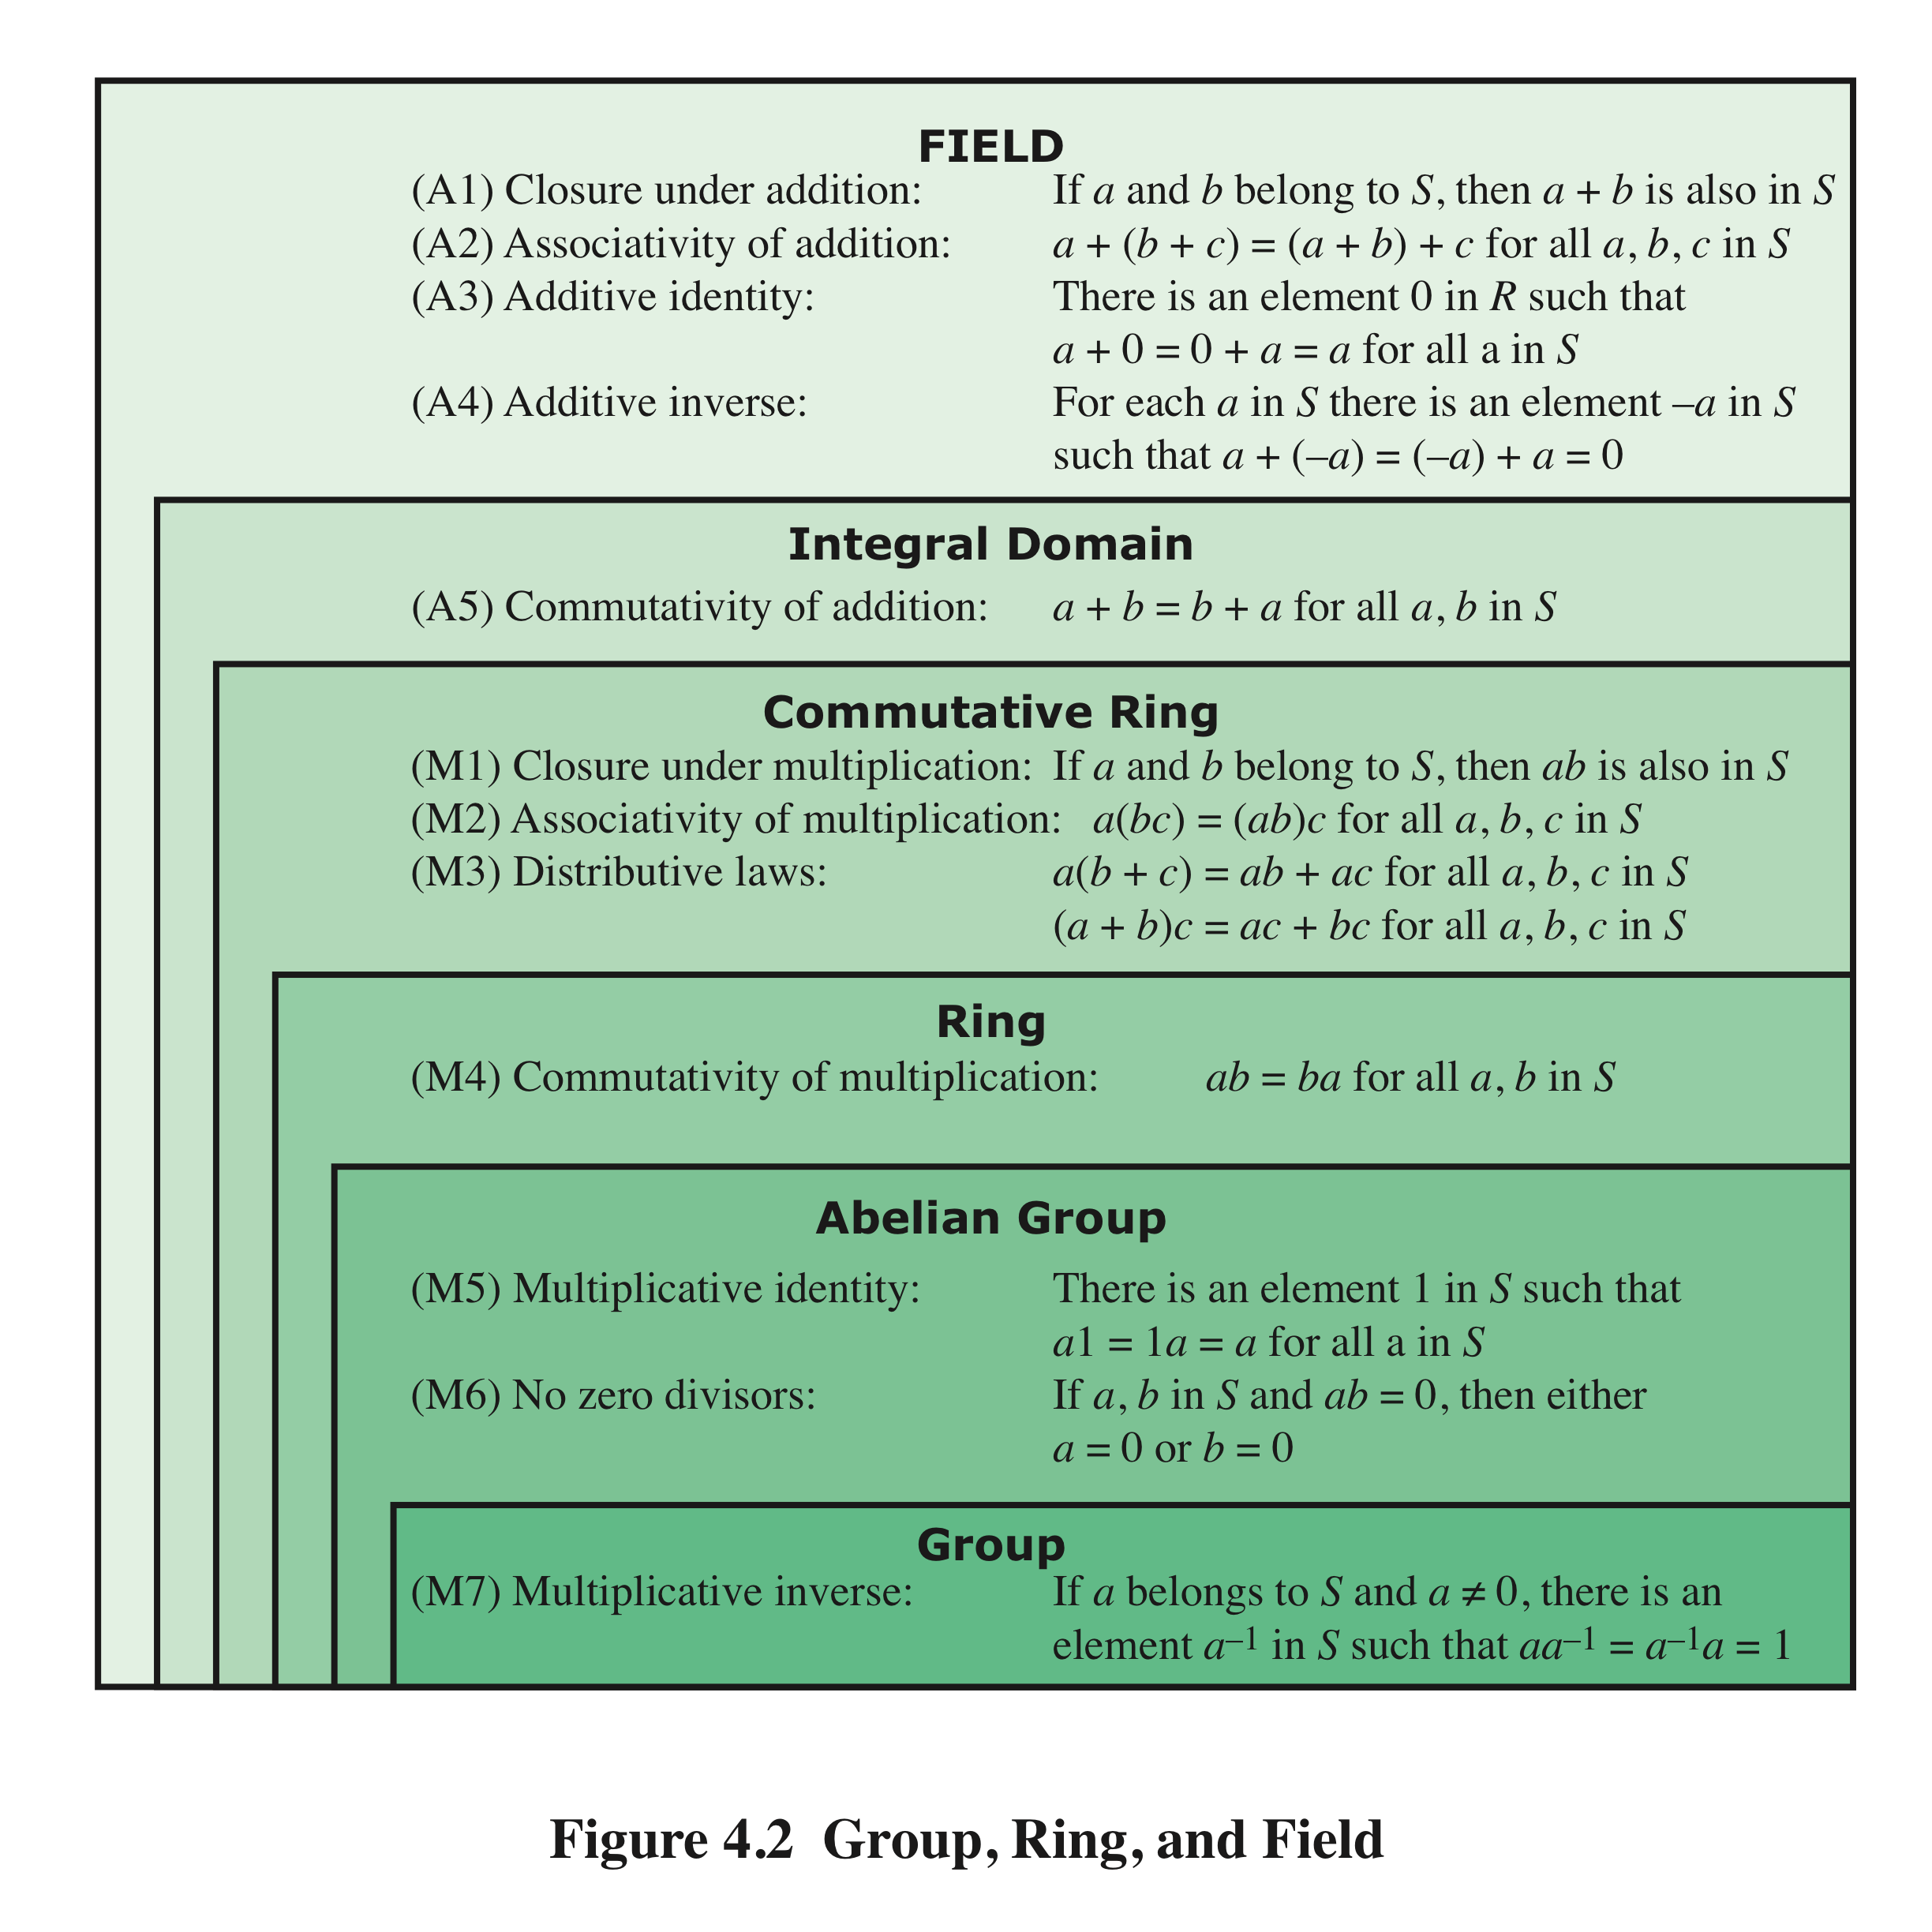
Group, Ring, and Field
Notes:
Figure 4.2 summarizes the axioms that define groups, rings, and fields.

Slide 29
Finite Fields of the Form GF(p)
Finite fields play a crucial role in many cryptographic algorithms
It can be shown that the order of a finite field must be a power of a prime p^{n}, where n is a positive integer
  The only positive integers that are divisors of p are p and 1
The finite field of order p^{n} is generally written GF(p^{n} )
  GF stands for Galois field, in honor of the mathematician who first studied finite fields
Notes:
In Section 4.4, we defined a field as a set that obeys all of the axioms of Figure 4.2
and gave some examples of infinite fields. Infinite fields are not of particular interest
in the context of cryptography. However, finite fields play a crucial role in many
cryptographic algorithms. It can be shown that the order of a finite field (number of
elements in the field) must be a power of a prime p^{n} , where n is a positive integer.
We discuss prime numbers in detail in Chapter 8. Here, we need only say that a
prime number is an integer whose only positive integer factors are itself and 1. That
is, the only positive integers that are divisors of p are p and 1.
The finite field of order p^{n} is generally written GF(p^{n}); GF stands for Galois
field, in honor of the mathematician who first studied finite fields. Two special cases
are of interest for our purposes. For n = 1, we have the finite field GF(p); this finite
field has a different structure than that for finite fields with n > 1 and is studied in
this section. In Section 4.7, we look at finite fields of the form GF(2^{n}).

Slide 30
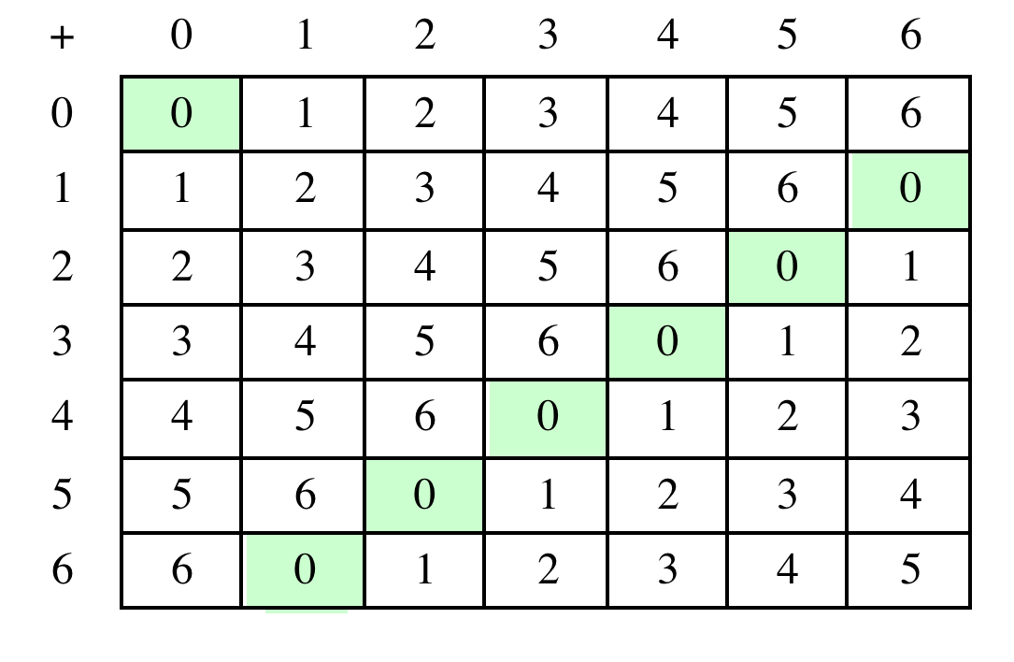
Table 4.5(a) Arithmetic in GF(7)
(a) Addition modulo 7
Notes:
Table 4.5 shows arithmetic operations in GF(7). This is a field of order 7 using
modular arithmetic modulo 7. As can be seen, it satisfies all of the properties required
of a field (Figure 4.2). Compare this table with Table 4.2. In the latter case,
we see that the set Z₈ , using modular arithmetic modulo 8, is not a field. Later in
this chapter, we show how to define addition and multiplication operations on Z₈
in such a way as to form a finite field.

Slide 31
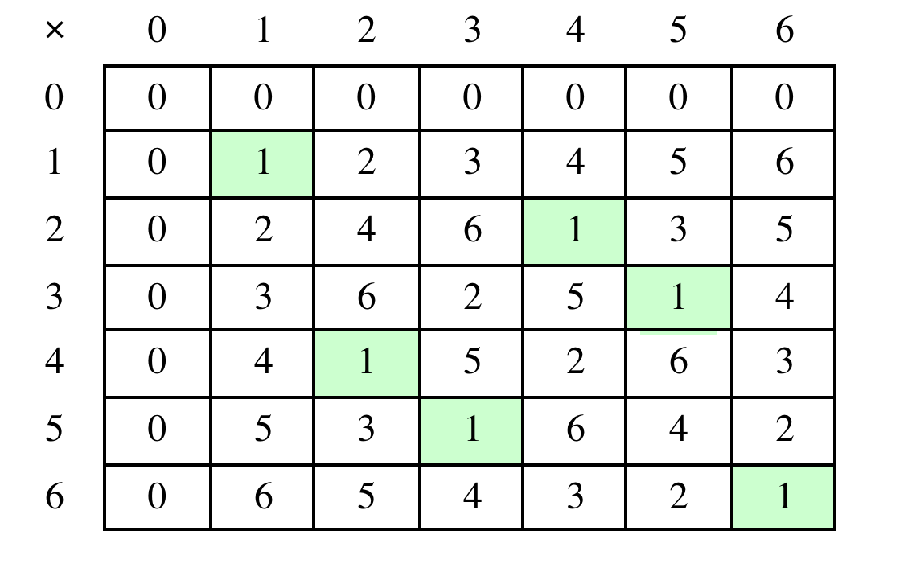
Table 4.5(b) Arithmetic in GF(7)
(b) Multiplication modulo 7
Notes:
Table 4.5 shows arithmetic operations in GF(7).

Slide 32
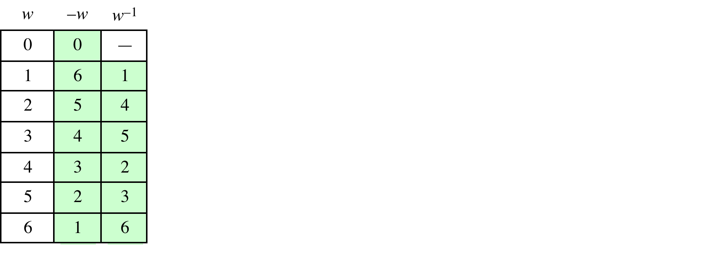
Table 4.5(c)
Arithmetic in GF(7)
(c) Additive and multiplicative inverses modulo 7
Notes:
Table 4.5 shows arithmetic operations in GF(7).

Slide 33
In this section, we have shown how to construct a finite field of order p, where p is prime.
GF(p) is defined with the following properties:
1. GF(p) consists of p elements
2. The binary operations + and * are defined over the set. The operations of addition, subtraction, multiplication, and division can be performed without leaving the set. Each element of the set other than 0 has a multiplicative inverse
We have shown that the elements of GF(p) are the integers {0, 1, . . . , p – 1} and that the arithmetic operations are addition and multiplication mod p
Notes:
In this section, we have shown how to construct a finite field of order p, where p is prime.
GF(p) is defined with the following properties:
GF(p) consists of p elements
2. The binary operations + and * are defined over the set. The operations of addition, subtraction, multiplication, and division can be performed without leaving the set. Each element of the set other than 0 has a multiplicative inverse
We have shown that the elements of GF(p) are the integers {0, 1, . . . , p – 1} and that the arithmetic operations are addition and multiplication mod p

Slide 34
Polynomial Arithmetic
We can distinguish three classes of polynomial arithmetic:
• Ordinary polynomial arithmetic, using the basic rules of algebra
• Polynomial arithmetic in which the arithmetic on the coefficients is performed modulo p; that is, the coefficients are in GF(p )
• Polynomial arithmetic in which the coefficients are in GF(p ), and the polynomials are defined modulo a polynomial m (x ) whose highest power is some integer n
Notes:
Before continuing our discussion of finite fields, we need to introduce the interesting
subject of polynomial arithmetic. We are concerned with polynomials in a single
variable x , and we can distinguish three classes of polynomial arithmetic.
• Ordinary polynomial arithmetic, using the basic rules of algebra.
• Polynomial arithmetic in which the arithmetic on the coefficients is performed
modulo p ; that is, the coefficients are in GF(p ).
• Polynomial arithmetic in which the coefficients are in GF(p ), and the polynomials
are defined modulo a polynomial m (x ) whose highest power is some integer n .

Slide 35
Ordinary Polynomial Arithmetic Example
As an example:
let f(x) = x³ + x² + 2 and g(x) = x² - x + 1, where S is the set of integers
Then:
f(x) + g(x) = x³ + 2x² - x + 3
f(x) - g(x) = x³ + x + 1
f(x) * g(x) = x⁵ + 3x² - 2x + 2
Figures 4.3a through 4.3c show the manual calculations
Notes:
Polynomial arithmetic includes the operations of addition, subtraction, and multiplication, defined in the usual way, ie add or subtract corresponding coefficients, or multiply all terms by each other.

Slide 36
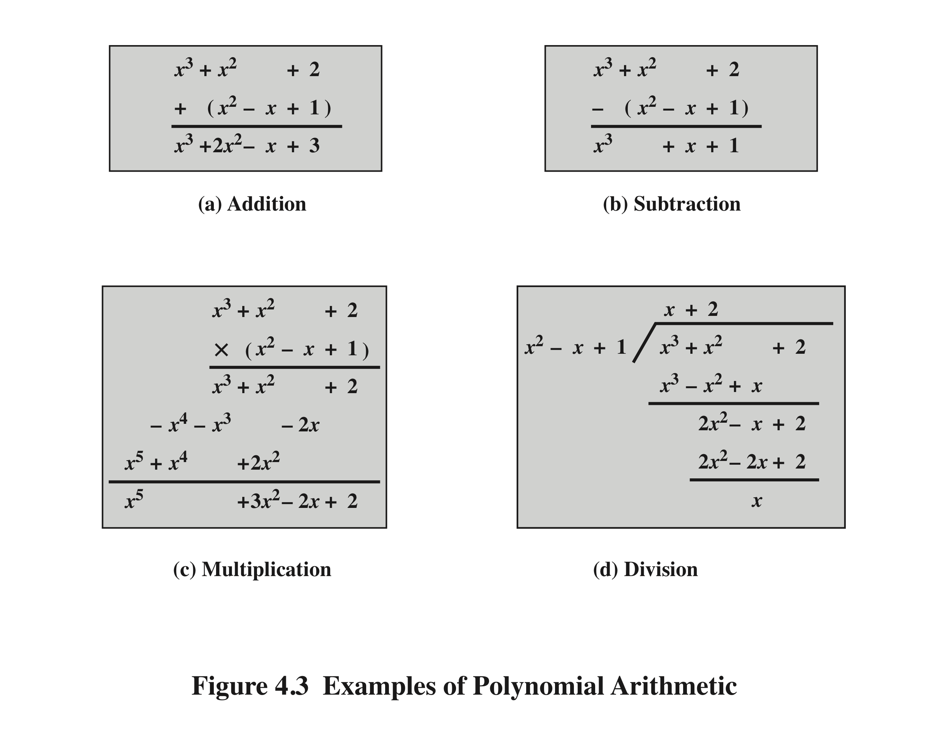
Notes:
Examples of Polynomial Arithmetic

Slide 37
Polynomial Arithmetic With Coefficients in Z_{p}
If each distinct polynomial is considered to be an element of the set, then that set is a ring
When polynomial arithmetic is performed on polynomials over a field, then division is possible
    Note: this does not mean that exact division is possible
    If we attempt to perform polynomial division over a coefficient set that is not a field, we find that division is not always defined
    Even if the coefficient set is a field, polynomial division is not necessarily exact
    With the understanding that remainders are allowed, we can say that polynomial division is possible if the coefficient set is a field
Notes:
Let us now consider polynomials in which the coefficients are elements of some
field F; we refer to this as a polynomial over the field F. In that case, it is easy to
show that the set of such polynomials is a ring, referred to as a polynomial ring .
That is, if we consider each distinct polynomial to be an element of the set, then
that set is a ring.
When polynomial arithmetic is performed on polynomials over a field, then
division is possible. Note that this does not mean that exact division is possible.
Let us clarify this distinction. Within a field, given two elements a and b , the
quotient a /b is also an element of the field. However, given a ring R that is not a
field, in general, division will result in both a quotient and a remainder; this is not
exact division.
Now, if we attempt to perform polynomial division over a coefficient set that
is not a field, we find that division is not always defined.
However, as we demonstrate presently, even if the coefficient set is a field,
polynomial division is not necessarily exact. In general, division will produce a quotient
and a remainder.
With the understanding that remainders are allowed, we can say that polynomial
division is possible if the coefficient set is a field.

Slide 38
Polynomial Division
We can write any polynomial in the form:
  f(x) = q(x) g(x) + r(x)
  r(x) can be interpreted as being a remainder
  So r(x) = f(x) mod g(x)
If there is no remainder we can say g(x) divides f(x)
  Written as g(x) | f(x)
  We can say that g(x) is a factor of f(x)
  Or g(x) is a divisor of f(x)
A polynomial f(x) over a field F is called irreducible if and only if f(x) cannot be expressed as a product of two polynomials, both over F, and both of degree lower than that of f(x)
  An irreducible polynomial is also called a prime polynomial
Notes:
Note that we can write any polynomial in the form of f(x) = q(x) g(x) + r(x), where division of f(x) by g(x) results in a quotient q(x) and remainder r(x). Can then extend the concept of divisors from the integer case, and show that the Euclidean algorithm can be extended to find the greatest common divisor of two polynomials whose coefficients are elements of a field.
Define an irreducible (or prime) polynomial as one with no divisors other than itself & 1. If compute polynomial arithmetic modulo an irreducible polynomial, this forms a finite field, and the GCD & Inverse algorithms can be adapted for it.

Slide 39
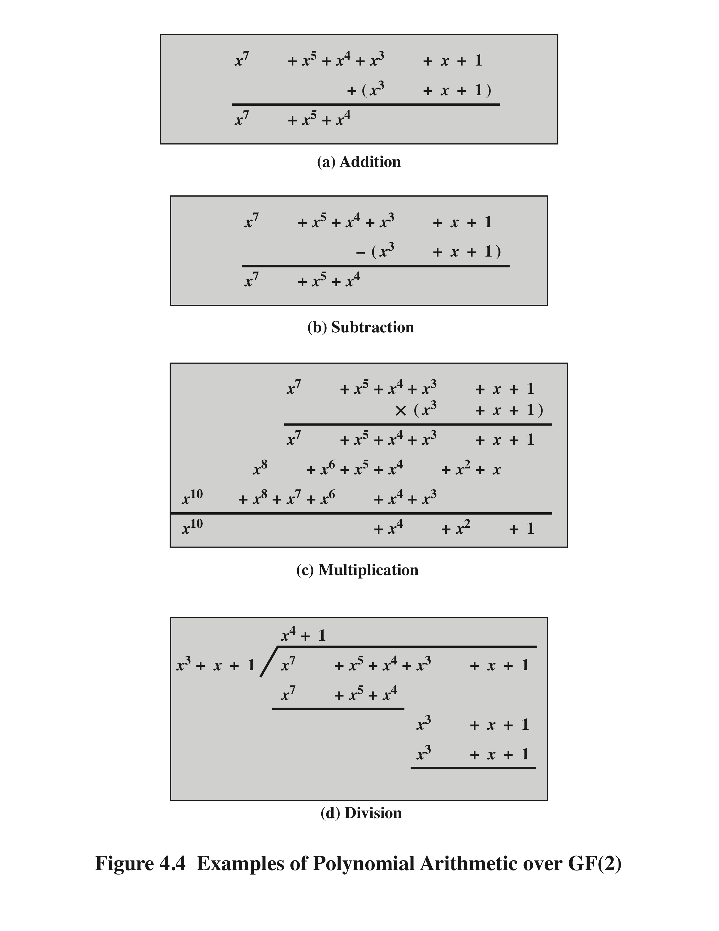
Example of Polynomial Arithmetic
Over GF(2)
(Figure 4.4 can be found on page 110 in the textbook)
Notes:
Figure 4.4 shows an example of polynomial arithmetic over GF(2).

Slide 40
Polynomial GCD
The polynomial c(x) is said to be the greatest common divisor of a(x) and b(x) if the following are true:
  c(x) divides both a(x) and b(x)
  Any divisor of a(x) and b(x) is a divisor of c(x)
An equivalent definition is:
  gcd[a(x), b(x)] is the polynomial of maximum degree that divides both a(x) and b(x)
The Euclidean algorithm can be extended to find the greatest common divisor of two polynomials whose coefficients are elements of a field
Notes:
We can extend the analogy between polynomial arithmetic over a field and integer
arithmetic by defining the greatest common divisor as follows. The polynomial c(x)
is said to be the greatest common divisor of a(x) and b(x) if the following are true.
1. c(x) divides both a(x) and b(x).
2. Any divisor of a(x) and b(x) is a divisor of c(x).
An equivalent definition is the following: gcd[a (x ), b (x )] is the polynomial of
maximum degree that divides both a (x ) and b (x ).
We can adapt the Euclidean algorithm to compute the greatest common
Divisor of two polynomials.

Slide 41
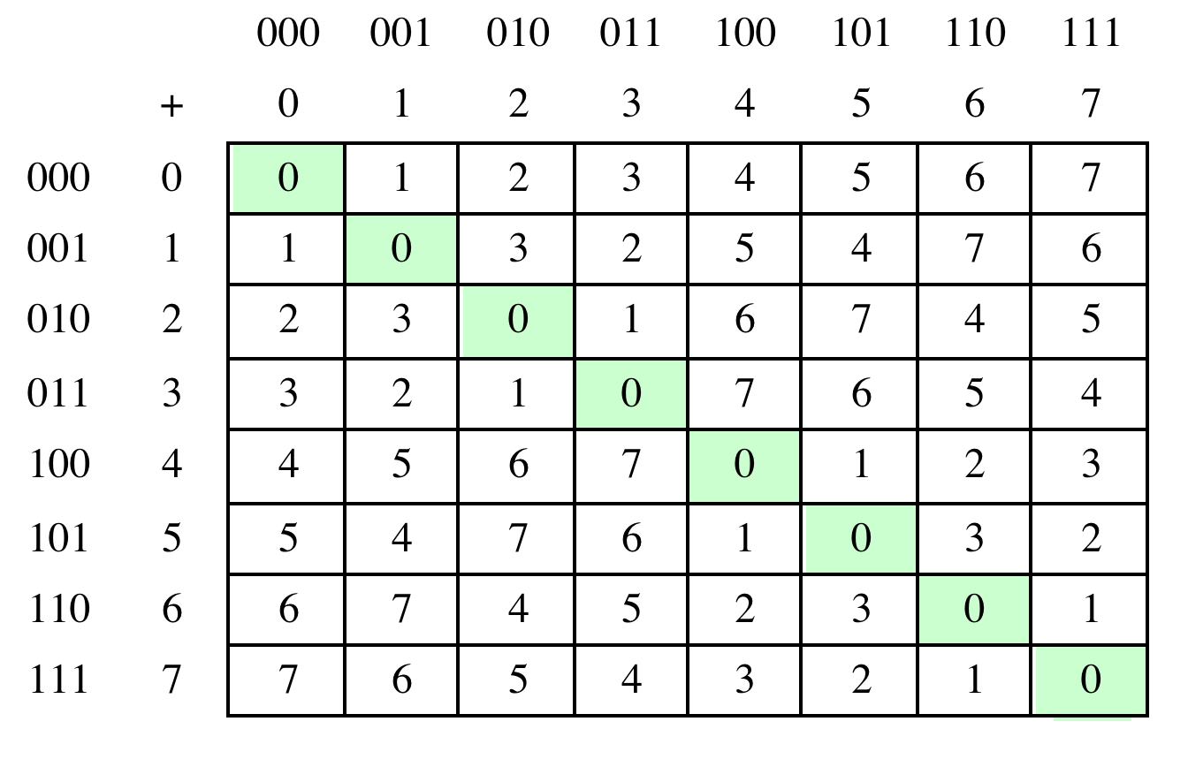
Table 4.6(a) Arithmetic in GF(2³)
(a) Addition
Notes:
Table 4.6 Arithmetic in GF(23)

Slide 42
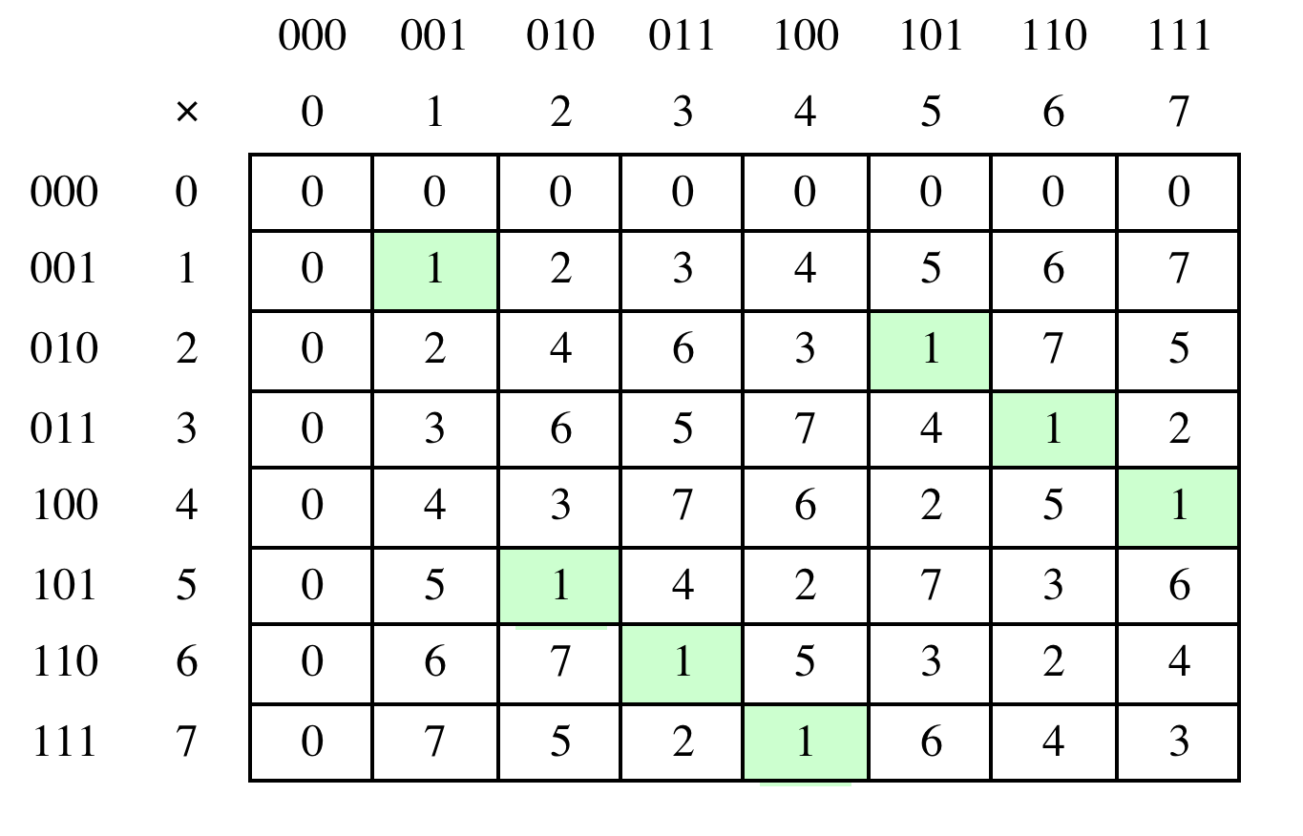
Table 4.6(b) Arithmetic in GF(2³)
(b) Multiplication
Notes:
Table 4.6 Arithmetic in GF(23)

Slide 43
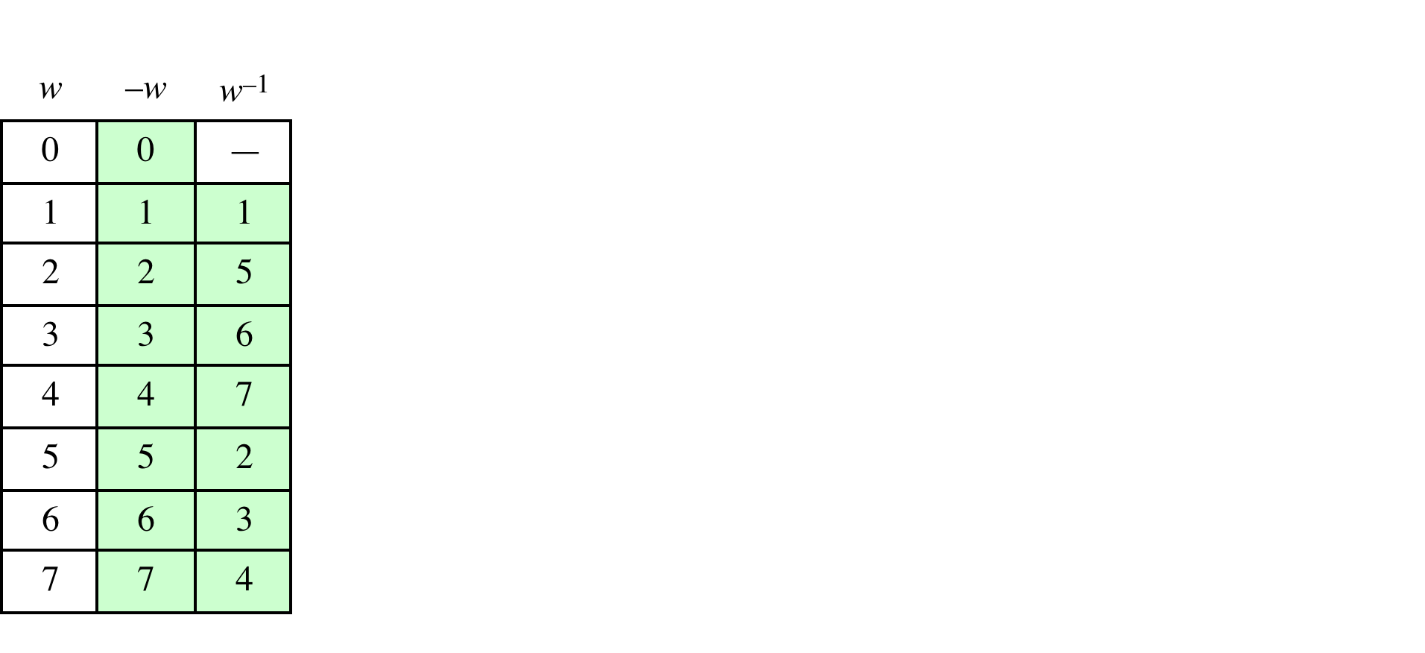
Table 4.6(c)
Arithmetic in GF(2³)
(c) Additive and multiplicative inverses
Notes:
Table 4.6 Arithmetic in GF(23)

Slide 44
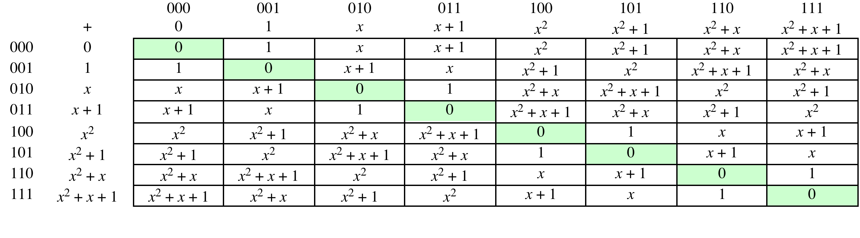
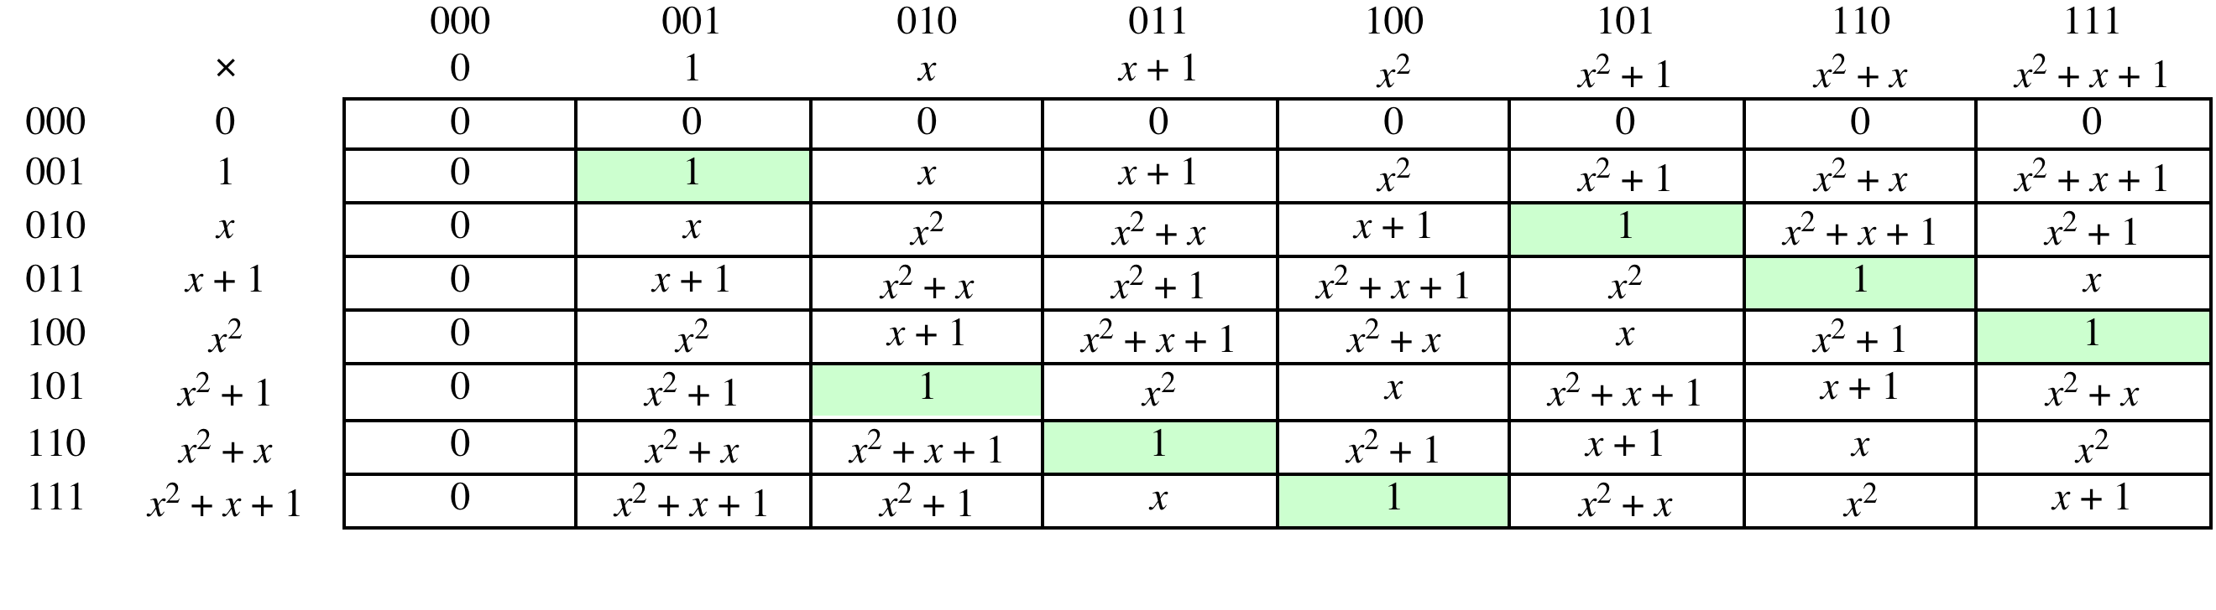
Table 4.7 Polynomial Arithmetic Modulo (x³ + x + 1)
(a) Addition
(b) Multiplication
(page 117 in textbook)
Notes:
Example shows addition & multiplication in GF(2³) modulo (x³+x+1)

Slide 45
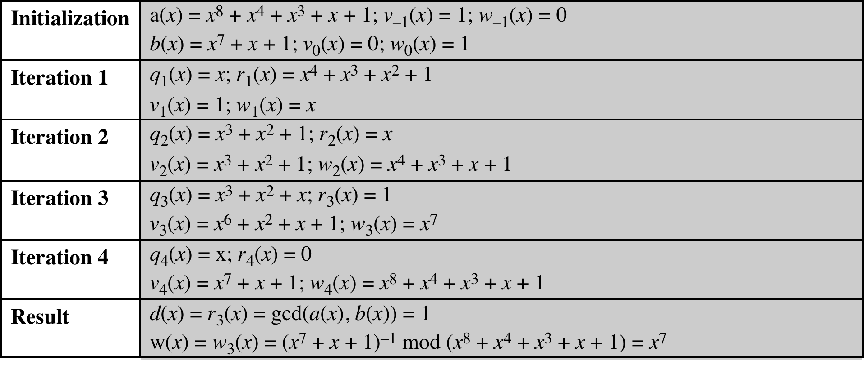
Table 4.8
Extended Euclid [(x⁸ + x⁴ + x³ + x + 1), (x⁷ + x + 1)]
(Table 4.8 can be found on page 118 in textbook)
Notes:
Table 4.8 Extended Euclid [(x8 + x4 + x3 + x + 1), (x7 + x + 1)]

Slide 46
Computational Considerations
Since coefficients are 0 or 1, they can represent any such polynomial as a bit string
Addition becomes XOR of these bit strings
Multiplication is shift and XOR
  cf long-hand multiplication
Modulo reduction is done by repeatedly substituting highest power with remainder of irreducible polynomial (also shift and XOR)
Notes:
A key motivation for using polynomial arithmetic in GF(2^{n}) is that the polynomials can be represented as a bit string, using all possible bit values, and the calculations only use simple common machine instructions - addition is just XOR, and multiplication is shifts & XOR’s. See text for additional discussion. The shortcut for polynomial reduction comes from the observation that if in GF(2^{n}) then irreducible poly g(x) has highest term x^{n} , and if compute x^{n} mod g(x) answer is g(x)- x^{n}

Slide 47
Using a Generator
A generator g of a finite field F of order q (contains q elements) is an element whose first q-1 powers generate all the nonzero elements of F
  The elements of F consist of 0, g⁰, g¹, . . . ., g^{q-2}
  Consider a field F defined by a polynomial f(x)
  An element b contained in F is called a root of the polynomial if f(b) = 0
  Finally, it can be shown that a root g of an irreducible polynomial is a generator of the finite field defined on that polynomial
Notes:
An equivalent technique for defining a finite field of the form GF(2^{n} ), using the
same irreducible polynomial, is sometimes more convenient. To begin, we need two
definitions: A generator g of a finite field F of order q (contains q elements) is an
element whose first q - 1 powers generate all the nonzero elements of F. That is, the
elements of F consist of 0, g⁰ , g¹ , c , g^{q-2} . Consider a field F defined by a polynomial
f (x ). An element b contained in F is called a root of the polynomial if f (b ) = 0.
Finally, it can be shown that a root g of an irreducible polynomial is a generator of the
finite field defined on that polynomial.

Slide 48
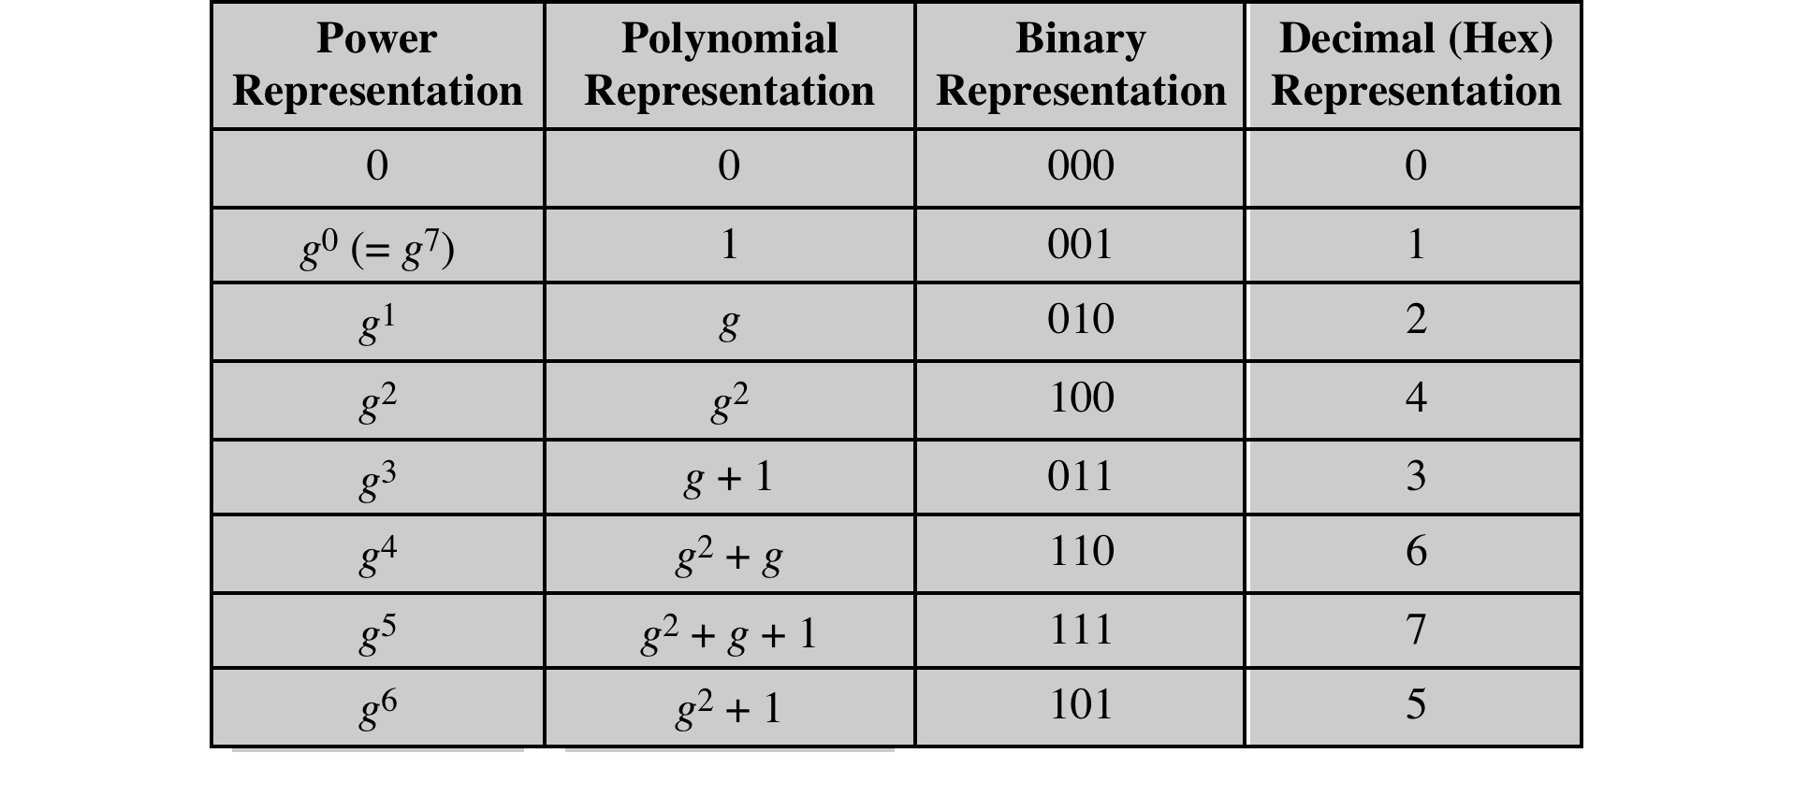
Table 4.9
Generator for GF(2³) using x³ + x + 1
Notes:
Table 4.9 Generator for GF(2³) using x³ + x + 1

Slide 49
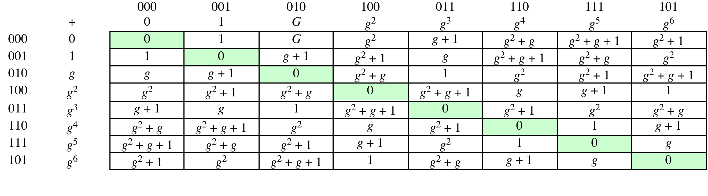
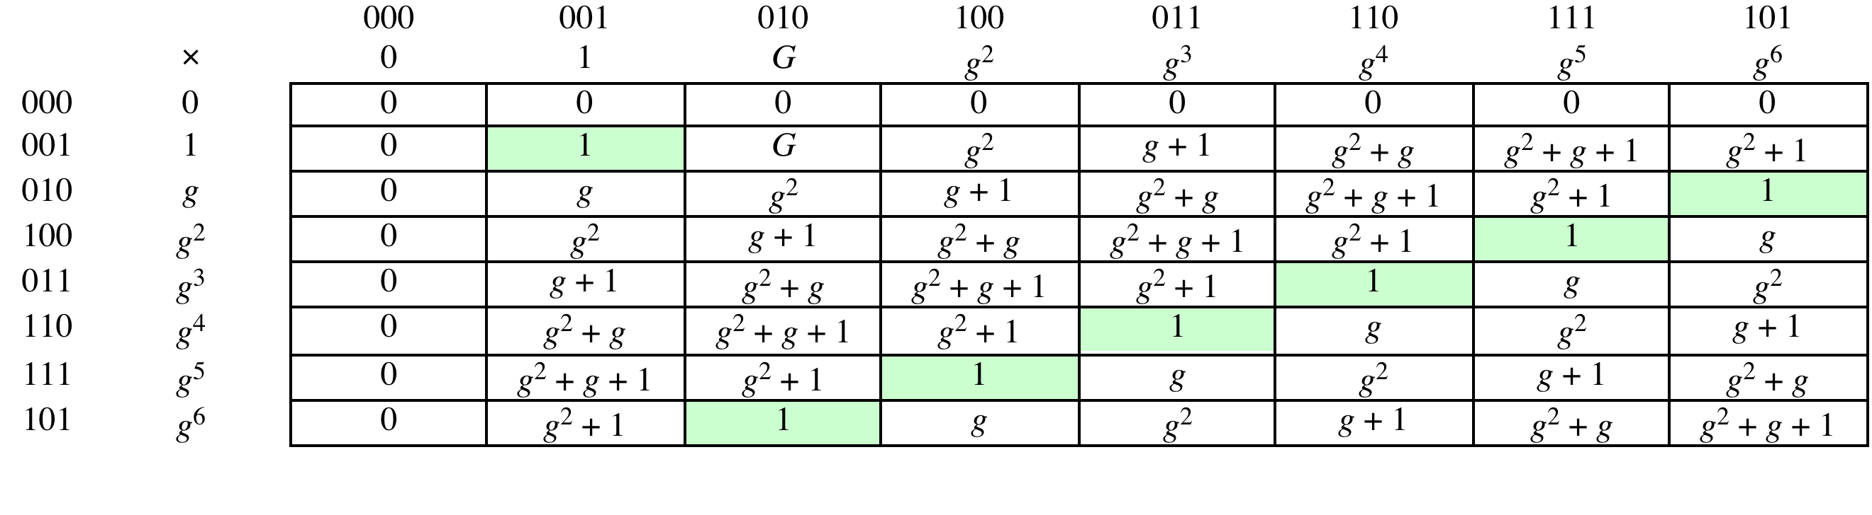
Table 4.10
GF(2³) Arithmetic Using Generator for the Polynomial (x³ + x + 1)
(a) Addition
(b) Multiplication
(page 123 in textbook)
Notes:
Table 4.10 GF(2³) Arithmetic Using Generator for the Polynomial (x³ + x + 1)

Slide 50
Summary
Divisibility and the division algorithm
The Euclidean algorithm
Modular arithmetic
Groups, rings, and fields
Finite fields of the form GF(p)
Polynomial arithmetic
Finite fields of the form GF(2^{n})
Notes:
Chapter 4 summary.

Slide 51
Chapter 5
Advanced Encryption Standard
Notes:
The Advanced Encryption Standard (AES) was published by the National Institute
of Standards and Technology (NIST) in 2001. AES is a symmetric block cipher that
is intended to replace DES as the approved standard for a wide range of applications.
Compared to public-key ciphers such as RSA, the structure of AES and most symmetric
ciphers is quite complex and cannot be explained as easily as many other cryptographic
algorithms. Accordingly, the reader may wish to begin with a simplified version
of AES, which is described in Appendix 5B. This version allows the reader to perform
encryption and decryption by hand and gain a good understanding of the working of
the algorithm details. Classroom experience indicates that a study of this simplified
version enhances understanding of AES. One possible approach is to read the chapter
first, then carefully read Appendix 5B, and then re-read the main body of the chapter.

Slide 52
“It seems very simple.”
“It is very simple. But if you don’t know what the key is it’s virtually indecipherable.”
—Talking to Strange Men,
Ruth Rendell
Notes:
Appendix H looks at the evaluation criteria used by NIST to select from among
the candidates for AES, plus the rationale for picking Rijndael, which was the winning
candidate. This material is useful in understanding not just the AES design but also the
criteria by which to judge any symmetric encryption algorithm.

Slide 53
Finite Field Arithmetic
In the Advanced Encryption Standard (AES) all operations are performed on 8-bit bytes
The arithmetic operations of addition, multiplication, and division are performed over the finite field GF(2⁸)
A field is a set in which we can do addition, subtraction, multiplication, and division without leaving the set
Division is defined with the following rule:
  a /b = a (b⁻¹ )
  An example of a finite field (one with a finite number of elements) is the set Z_{p} consisting of all the integers {0, 1, . . . . , p - 1}, where p is a prime number and in which arithmetic is carried out modulo p
Notes:
In AES, all operations are performed on 8-bit bytes. In particular, the arithmetic
operations of addition, multiplication, and division are performed over the finite
field GF(28 ). Section 4.7 discusses such operations in some detail. For the reader
who has not studied Chapter 4, and as a quick review for those who have, this
section summarizes the important concepts.
In essence, a field is a set in which we can do addition, subtraction, multiplication,
and division without leaving the set. Division is defined with the following
rule: a /b = a (b⁻¹ ). An example of a finite field (one with a finite number of elements)
is the set Z_{p} consisting of all the integers {0, 1, . . . . , p - 1}, where p is a prime number
and in which arithmetic is carried out modulo p .

Slide 54
Finite Field Arithmetic
If one of the operations used in the algorithm is division, then we need to work in arithmetic defined over a field
Division requires that each nonzero element have a multiplicative inverse
For convenience and for implementation efficiency we would like to work with integers that fit exactly into a given number of bits with no wasted bit patterns
Integers in the range 0 through 2^{n} – 1, which fit into an n-bit word
The set of such integers, Z₂^{n}, using modular arithmetic, is not a field
For example, the integer 2 has no multiplicative inverse in Z₂^{n}, that is, there is no integer b, such that 2b mod 2^{n} = 1
A finite field containing 2^{n} elements is referred to as GF(2^{n})
Every polynomial in GF(2^{n}) can be represented by an n-bit number
Notes:
Virtually all encryption algorithms, both conventional and public-key, involve
arithmetic operations on integers. If one of the operations used in the algorithm
is division, then we need to work in arithmetic defined over a field; this is because
division requires that each nonzero element have a multiplicative inverse. For convenience
and for implementation efficiency, we would also like to work with integers
that fit exactly into a given number of bits, with no wasted bit patterns. That is,
we wish to work with integers in the range 0 through 2^{n} - 1, which fit into an n -bit
word. Unfortunately, the set of such integers, Z₂^{n} , using modular arithmetic, is not a
field. For example, the integer 2 has no multiplicative inverse in Z₂^{n} , that is, there is
no integer b , such that 2b mod 2^{n} = 1.
There is a way of defining a finite field containing 2^{n} elements; such a field is
referred to as GF(2^{n} ).

Slide 55
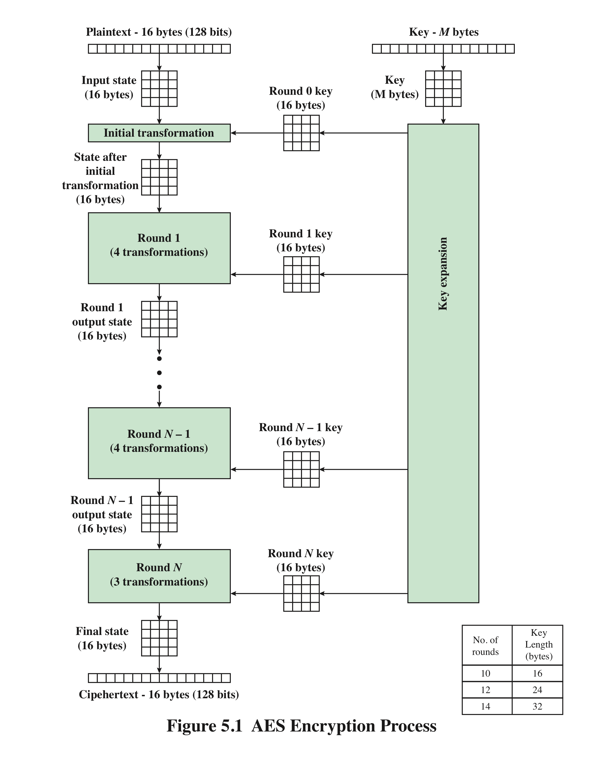
AES
Encryption Process
Notes:
Figure 5.1 shows the overall structure of the AES encryption process. The cipher
takes a plaintext block size of 128 bits, or 16 bytes. The key length can be 16, 24, or
32 bytes (128, 192, or 256 bits). The algorithm is referred to as AES-128, AES-192, or
AES-256, depending on the key length.

Slide 56
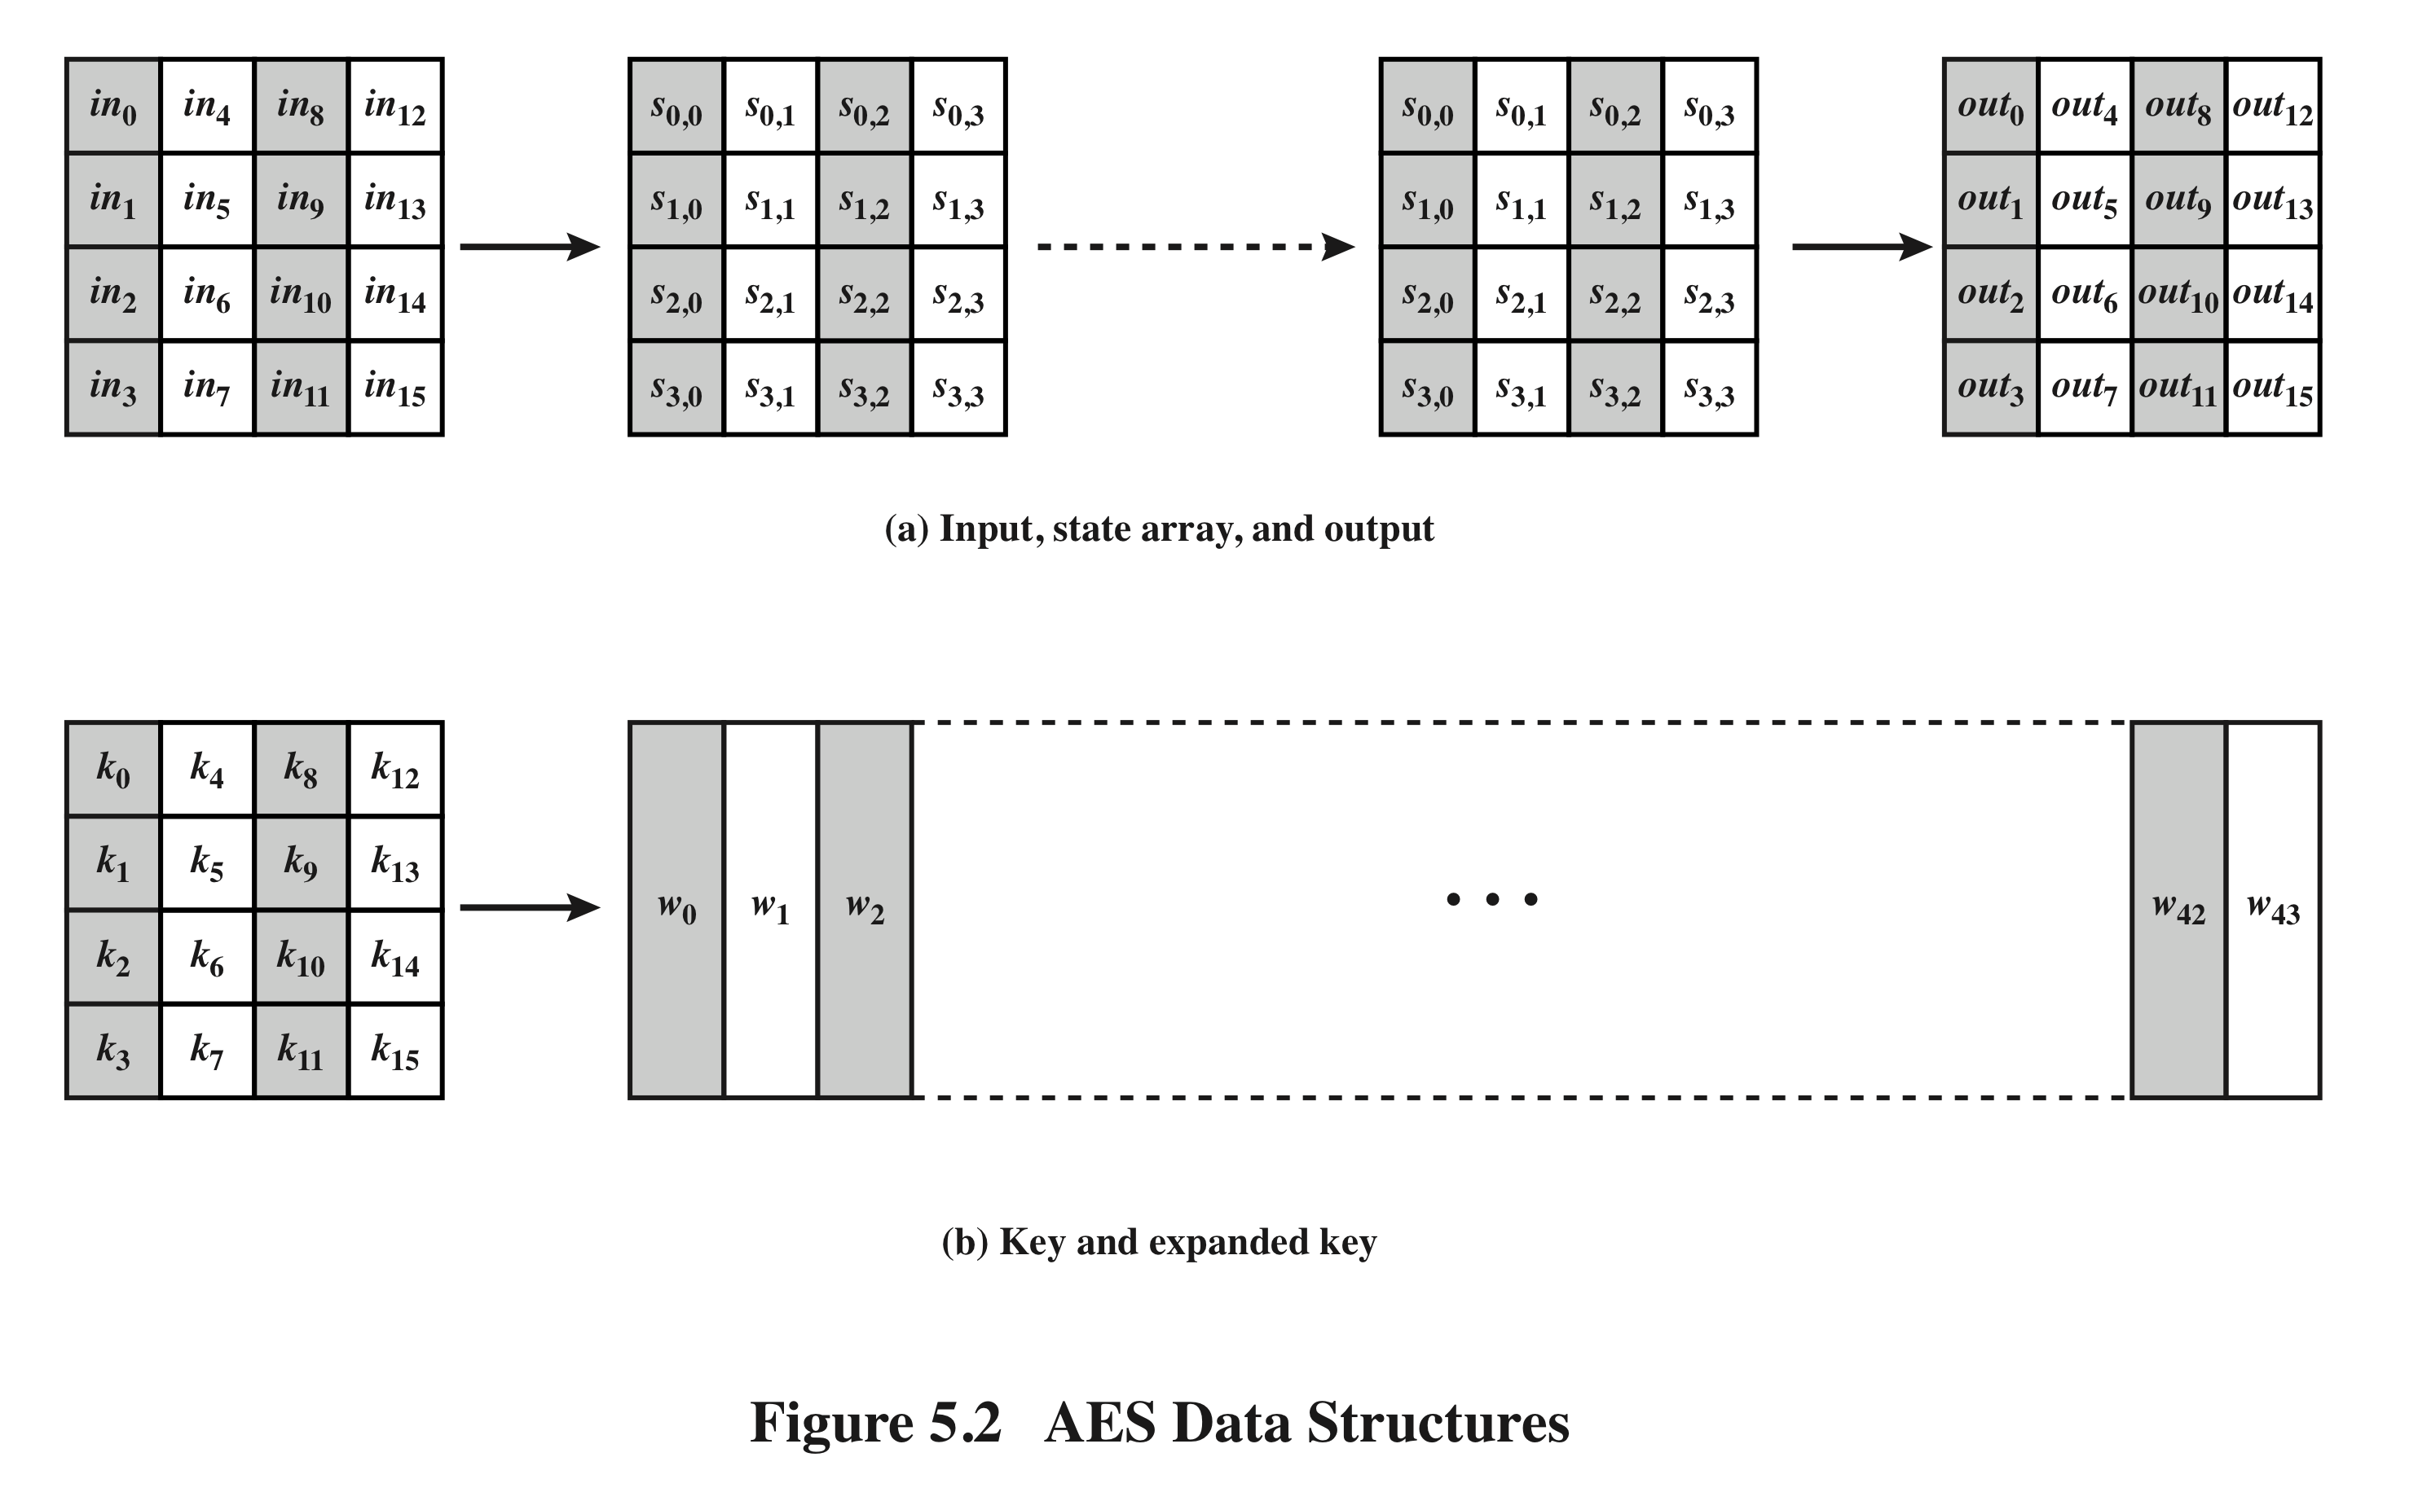
AES Data Structures
Notes:
The input to the encryption and decryption algorithms is a single 128-bit block.
In FIPS PUB 197, this block is depicted as a 4 * 4 square matrix of bytes. This
block is copied into the State array, which is modified at each stage of encryption or
decryption. After the final stage, State is copied to an output matrix. These operations
are depicted in Figure 5.2a. Similarly, the key is depicted as a square matrix of bytes.
This key is then expanded into an array of key schedule words. Figure 5.2b shows the
expansion for the 128-bit key. Each word is four bytes, and the total key schedule
is 44 words for the 128-bit key. Note that the ordering of bytes within a matrix is by
column. So, for example, the first four bytes of a 128-bit plaintext input to the encryption
cipher occupy the first column of the in matrix, the second four bytes occupy the
second column, and so on. Similarly, the first four bytes of the expanded key, which
form a word, occupy the first column of the w matrix.

Slide 57
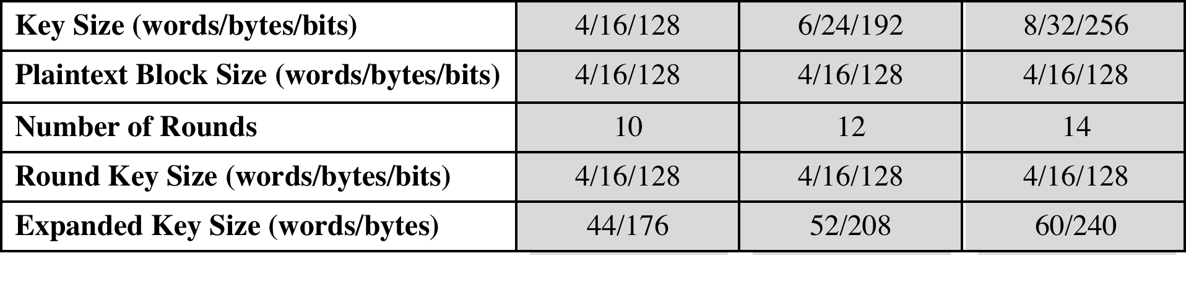
Table 5.1
AES Parameters
Notes:
The cipher consists of N rounds, where the number of rounds depends on the
key length: 10 rounds for a 16-byte key, 12 rounds for a 24-byte key, and 14 rounds
for a 32-byte key (Table 5.1). The first N - 1 rounds consist of four distinct transformation
functions: SubBytes, ShiftRows, MixColumns, and AddRoundKey, which are
described subsequently. The final round contains only three transformations, and
there is a initial single transformation (AddRoundKey) before the first round, which
can be considered Round 0. Each transformation takes one or more 4 * 4 matrices
as input and produces a 4 * 4 matrix as output. Figure 5.1 shows that the output of
each round is a 4 * 4 matrix, with the output of the final round being the ciphertext.
Also, the key expansion function generates N + 1 round keys, each of which is a distinct
4 * 4 matrix. Each round key serves as one of the inputs to the AddRoundKey
transformation in each round.

Slide 58
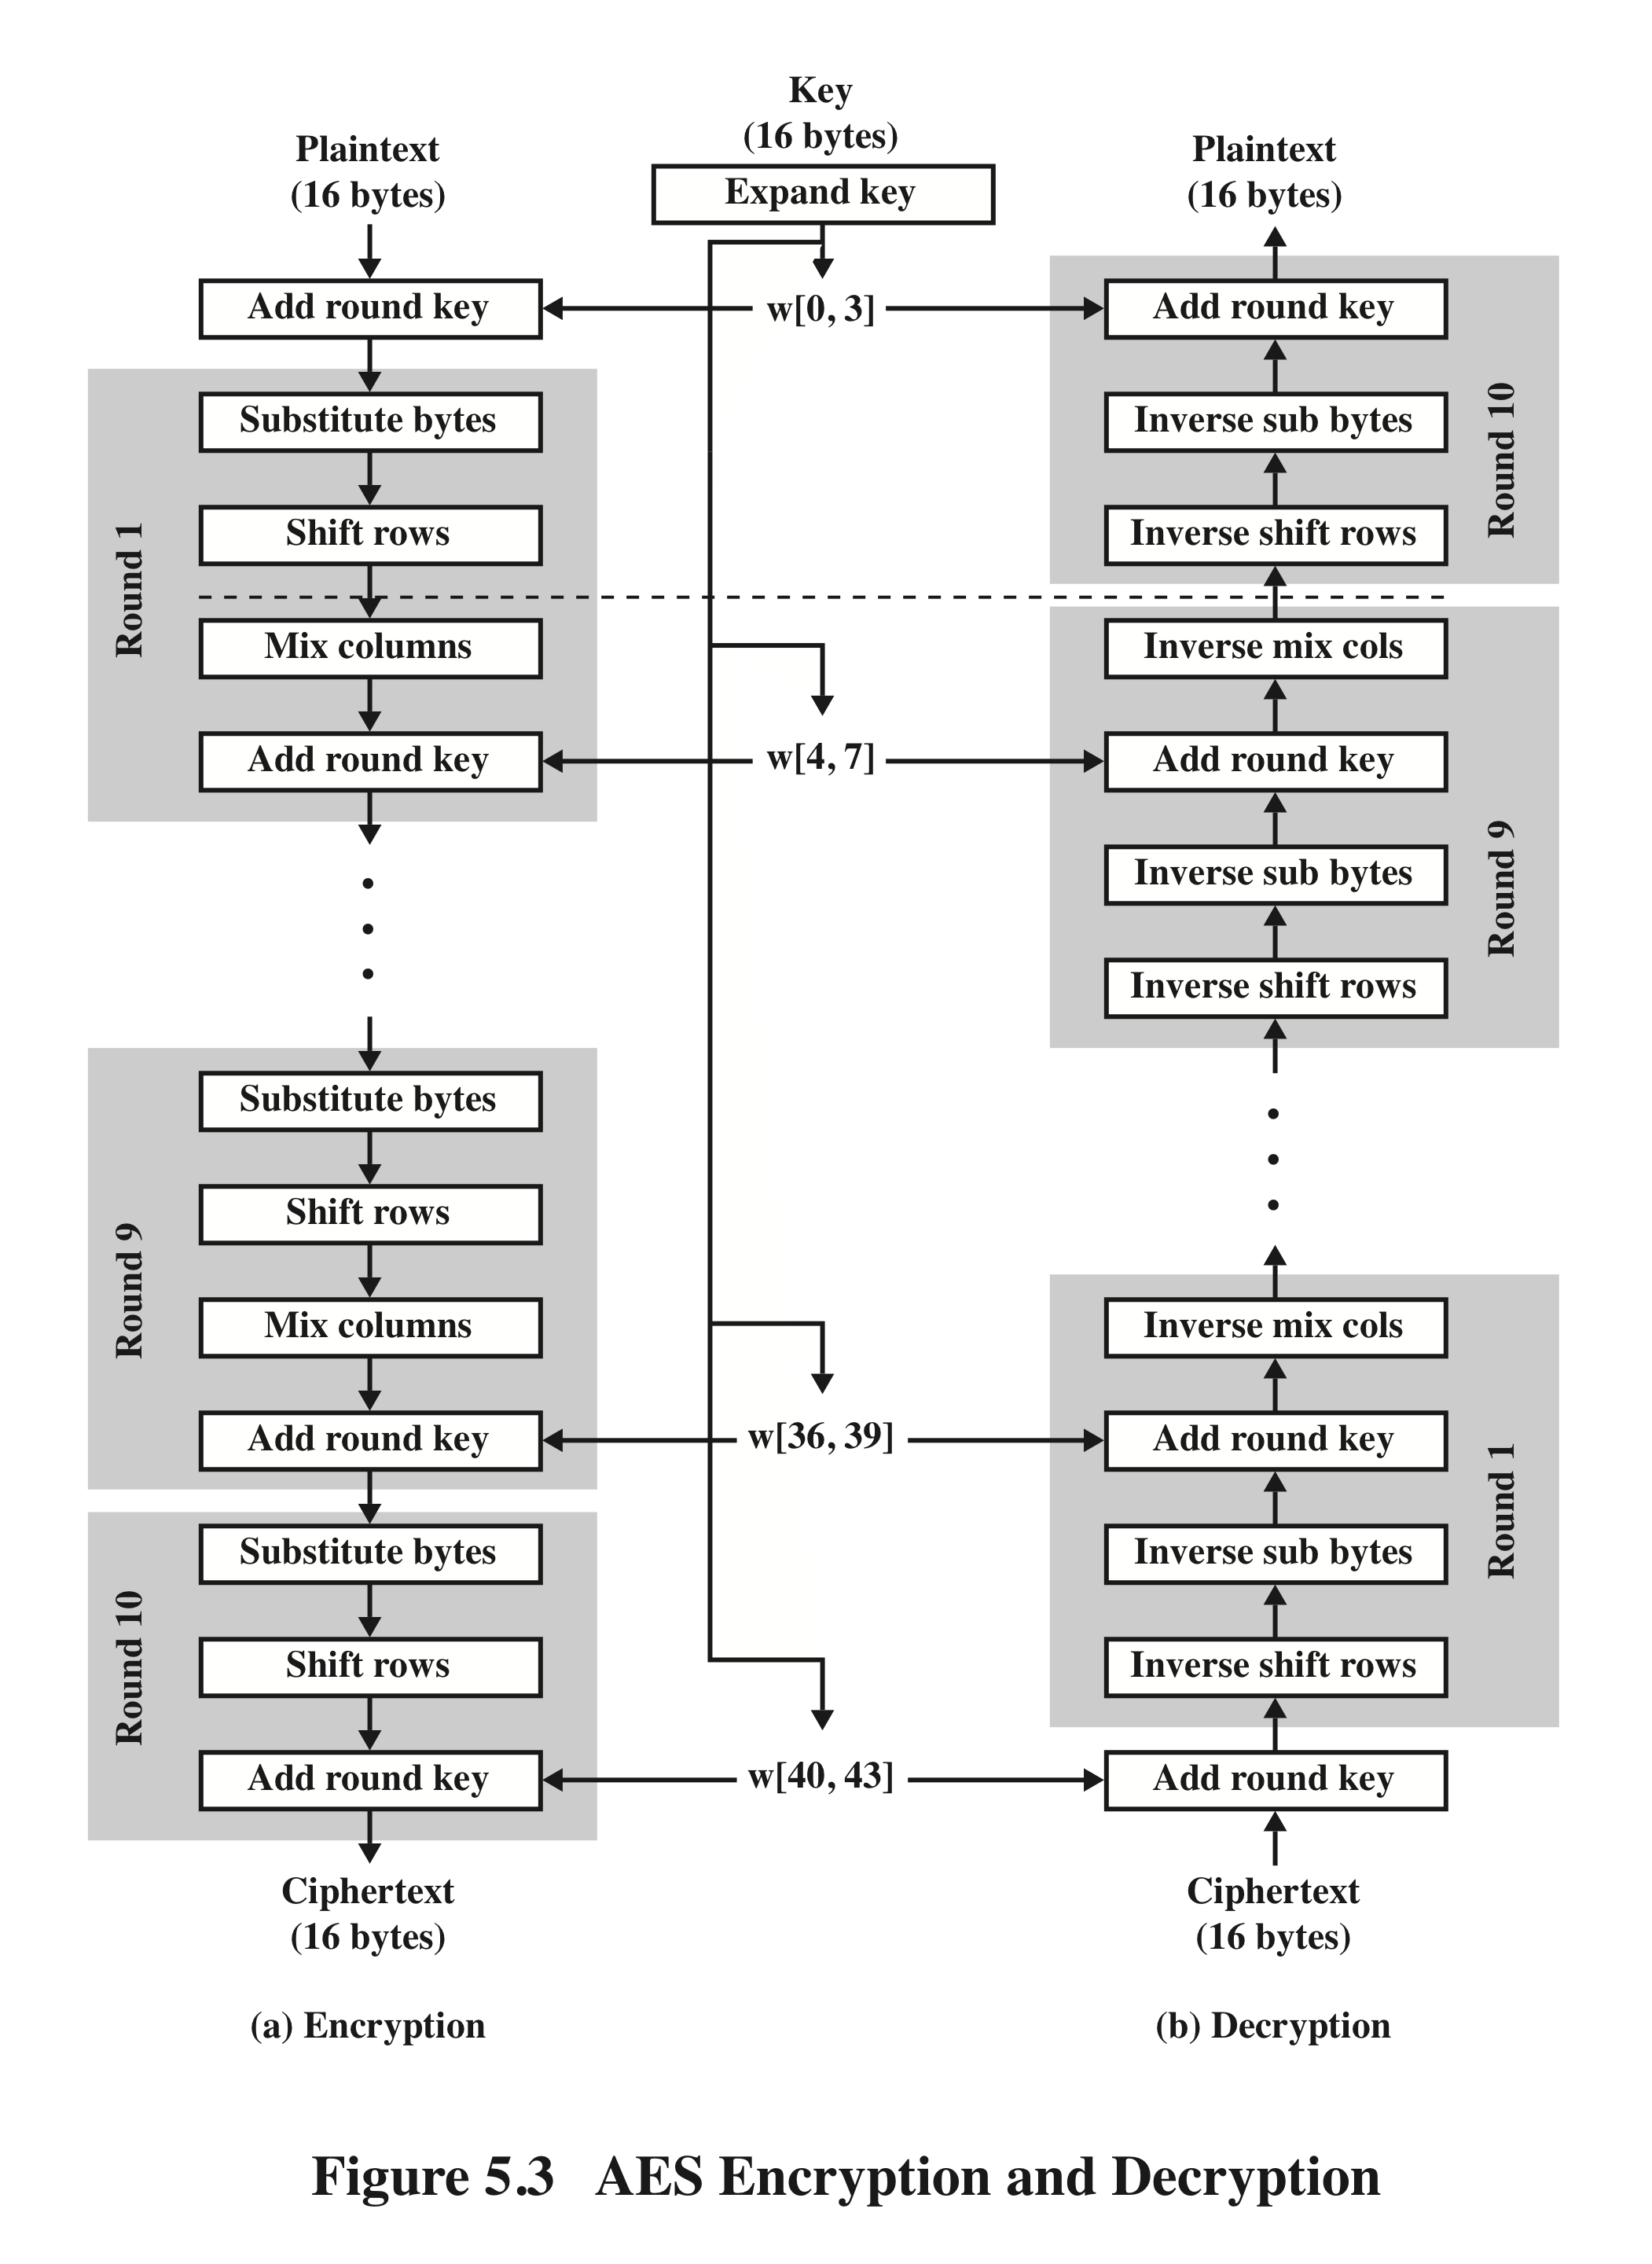
AES
Encryption and
Decryption
Notes:
Figure 5.3 shows the AES cipher in more detail, indicating the sequence of transformations
in each round and showing the corresponding decryption function. As was
done in Chapter 3, we show encryption proceeding down the page and decryption
proceeding up the page.

Slide 59
Detailed Structure
Processes the entire data block as a single matrix during each round using substitutions and permutation
The key that is provided as input is expanded into an array of forty-four 32-bit words, w[i]
The cipher begins and ends with an AddRoundKey stage
Can view the cipher as alternating operations of XOR encryption (AddRoundKey) of a block, followed by scrambling of the block (the other three stages), followed by XOR encryption, and so on
Each stage is easily reversible
The decryption algorithm makes use of the expanded key in reverse order, however the decryption algorithm is not identical to the encryption algorithm
State is the same for both encryption and decryption
Final round of both encryption and decryption consists of only three stages
Four different stages are used:
Substitute bytes – uses an S-box to perform a byte-by-byte substitution of the block
ShiftRows – a simple permutation
MixColumns – a substitution that makes use of arithmetic over GF(2⁸)
AddRoundKey – a simple bitwise XOR of the current block with a portion of the expanded key
Notes:
Before delving into details, we can make several comments about the overall
AES structure.
1. One noteworthy feature of this structure is that it is not a Feistel structure.
Recall that, in the classic Feistel structure, half of the data block is used to
modify the other half of the data block and then the halves are swapped. AES
instead processes the entire data block as a single matrix during each round
using substitutions and permutation.
2. The key that is provided as input is expanded into an array of forty-four 32-bit
words, w [i ]. Four distinct words (128 bits) serve as a round key for each round;
these are indicated in Figure 5.3.
3. Four different stages are used, one of permutation and three of substitution:
• Substitute bytes: Uses an S-box to perform a byte-by-byte substitution of
the block
• ShiftRows: A simple permutation
• MixColumns: A substitution that makes use of arithmetic over GF(28 )
• AddRoundKey: A simple bitwise XOR of the current block with a portion
of the expanded key
4. The structure is quite simple. For both encryption and decryption, the
cipher begins with an AddRoundKey stage, followed by nine rounds that each
includes all four stages, followed by a tenth round of three stages.
5. Only the AddRoundKey stage makes use of the key. For this reason, the cipher
begins and ends with an AddRoundKey stage. Any other stage, applied at the
beginning or end, is reversible without knowledge of the key and so would add
no security.
6. The AddRoundKey stage is, in effect, a form of Vernam cipher and by itself
would not be formidable. The other three stages together provide confusion,
diffusion, and nonlinearity, but by themselves would provide no security
because they do not use the key. We can view the cipher as alternating operations
of XOR encryption (AddRoundKey) of a block, followed by scrambling
of the block (the other three stages), followed by XOR encryption, and so on.
This scheme is both efficient and highly secure.
7. Each stage is easily reversible. For the Substitute Byte, ShiftRows, and
MixColumns stages, an inverse function is used in the decryption algorithm.
For the AddRoundKey stage, the inverse is achieved by XORing the same
round key to the block.
8. As with most block ciphers, the decryption algorithm makes use of the
expanded key in reverse order. However, the decryption algorithm is not
identical to the encryption algorithm. This is a consequence of the particular
structure of AES.
9. Once it is established that all four stages are reversible, it is easy to verify
that decryption does recover the plaintext. Figure 5.3 lays out encryption
and decryption going in opposite vertical directions. At each horizontal point
(e.g., the dashed line in the figure), State is the same for both encryption and
decryption.
10. The final round of both encryption and decryption consists of only three stages.
Again, this is a consequence of the particular structure of AES and is required
to make the cipher reversible.

Slide 60
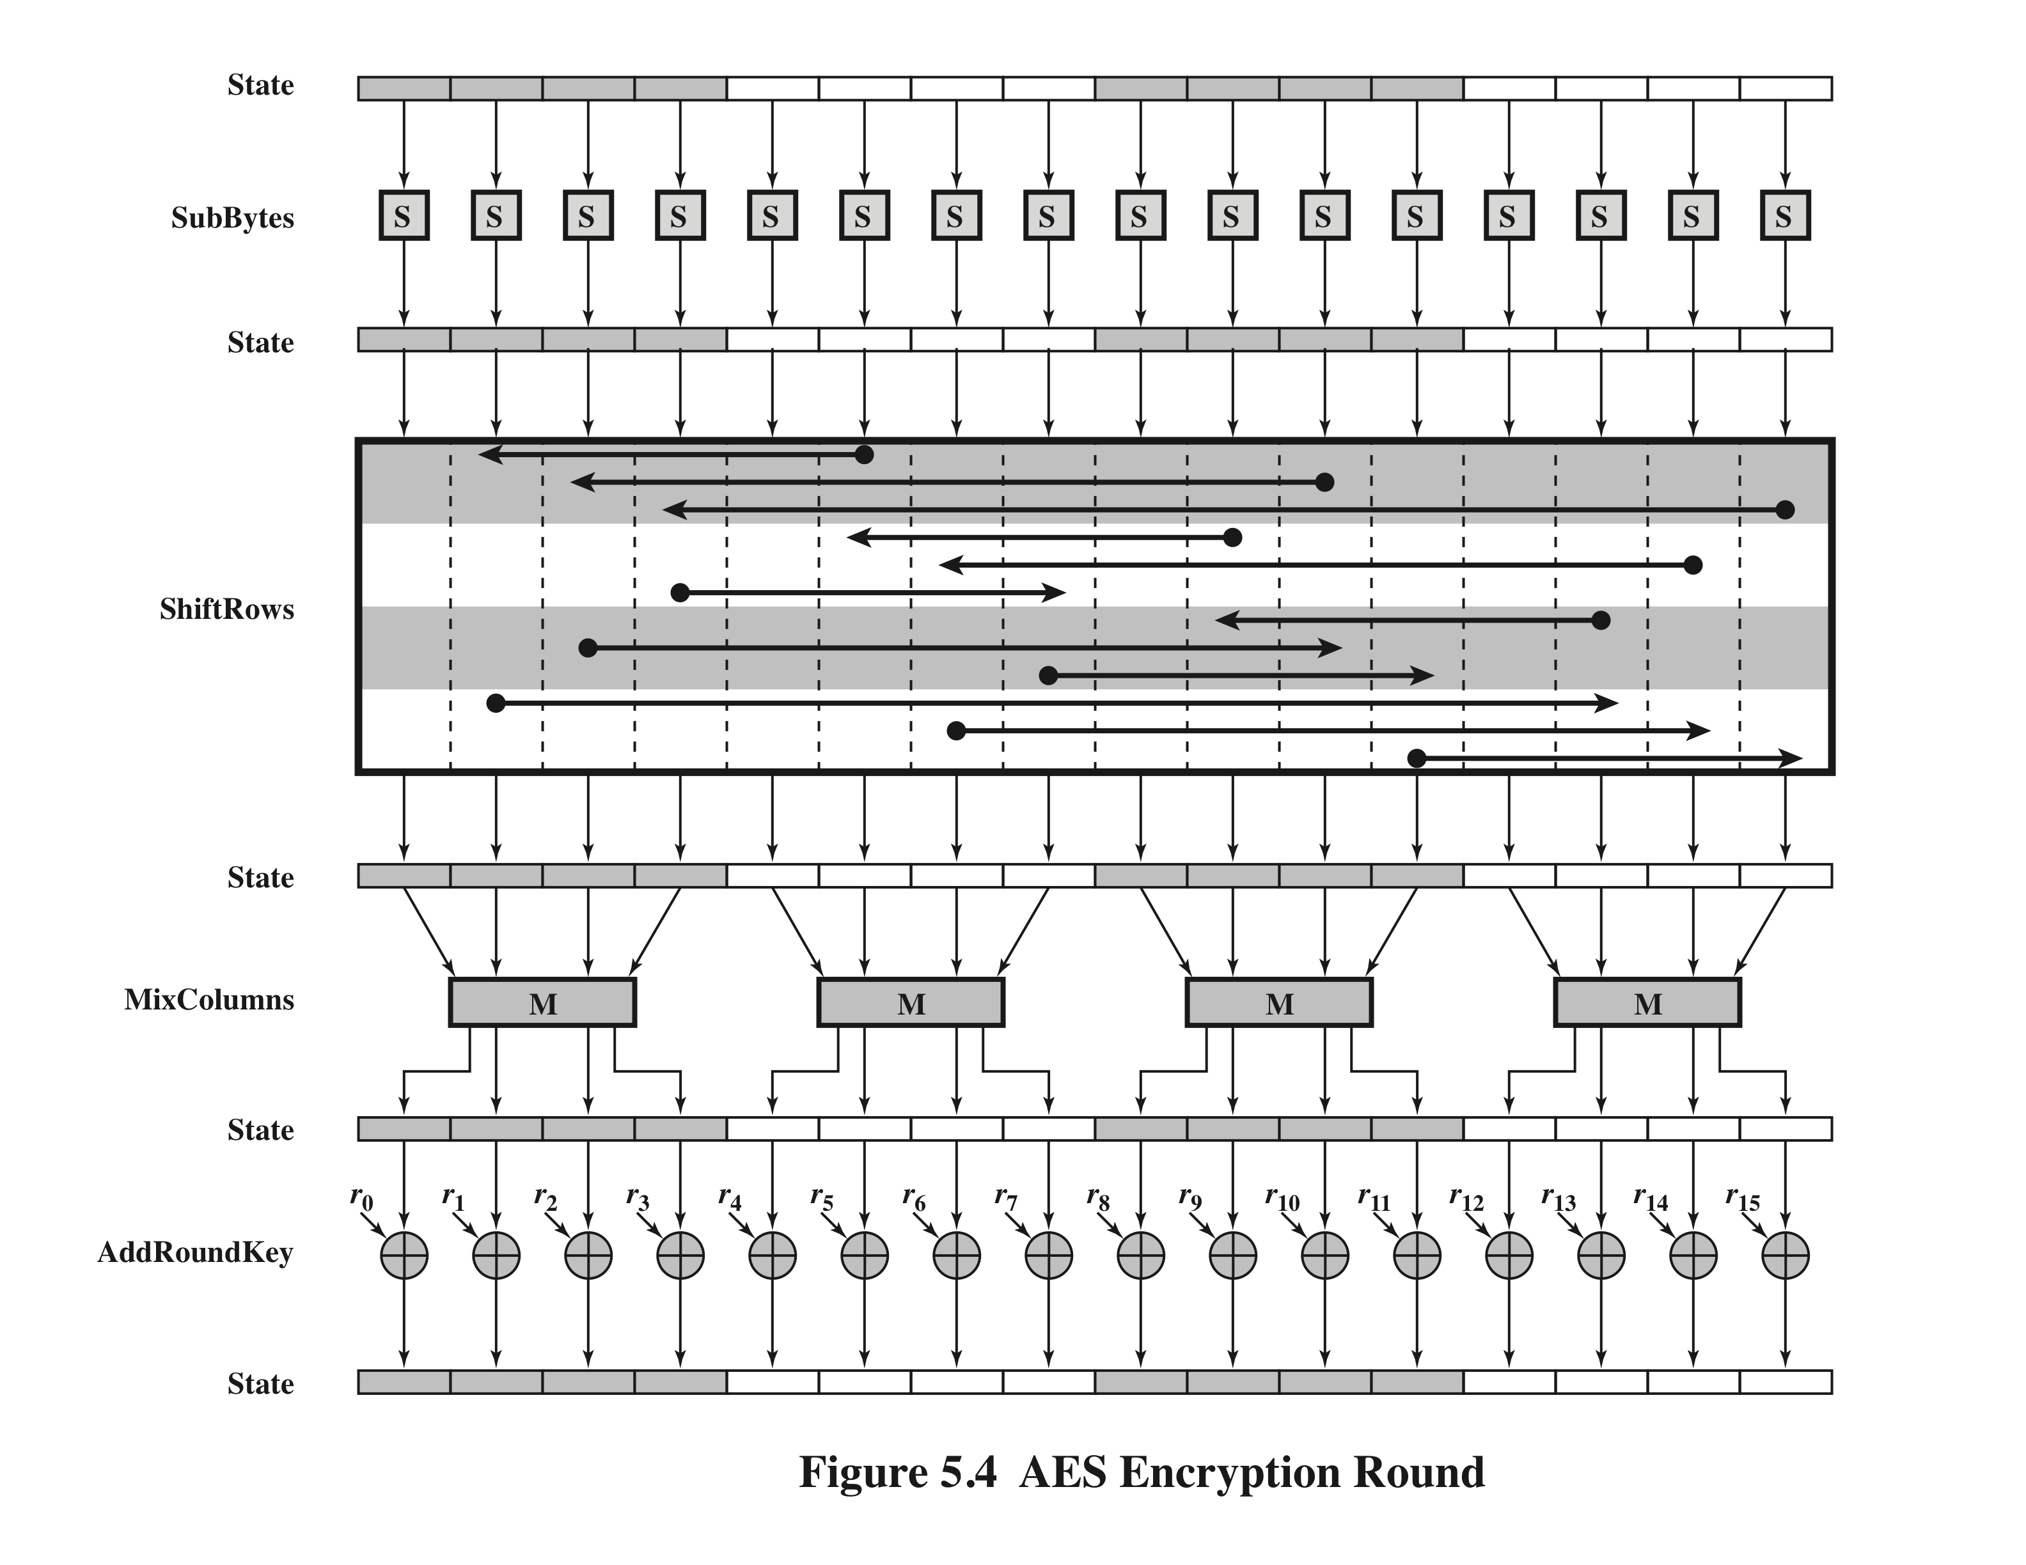
Notes:
Figure 5.4 depicts the structure of a full encryption round.

Slide 61
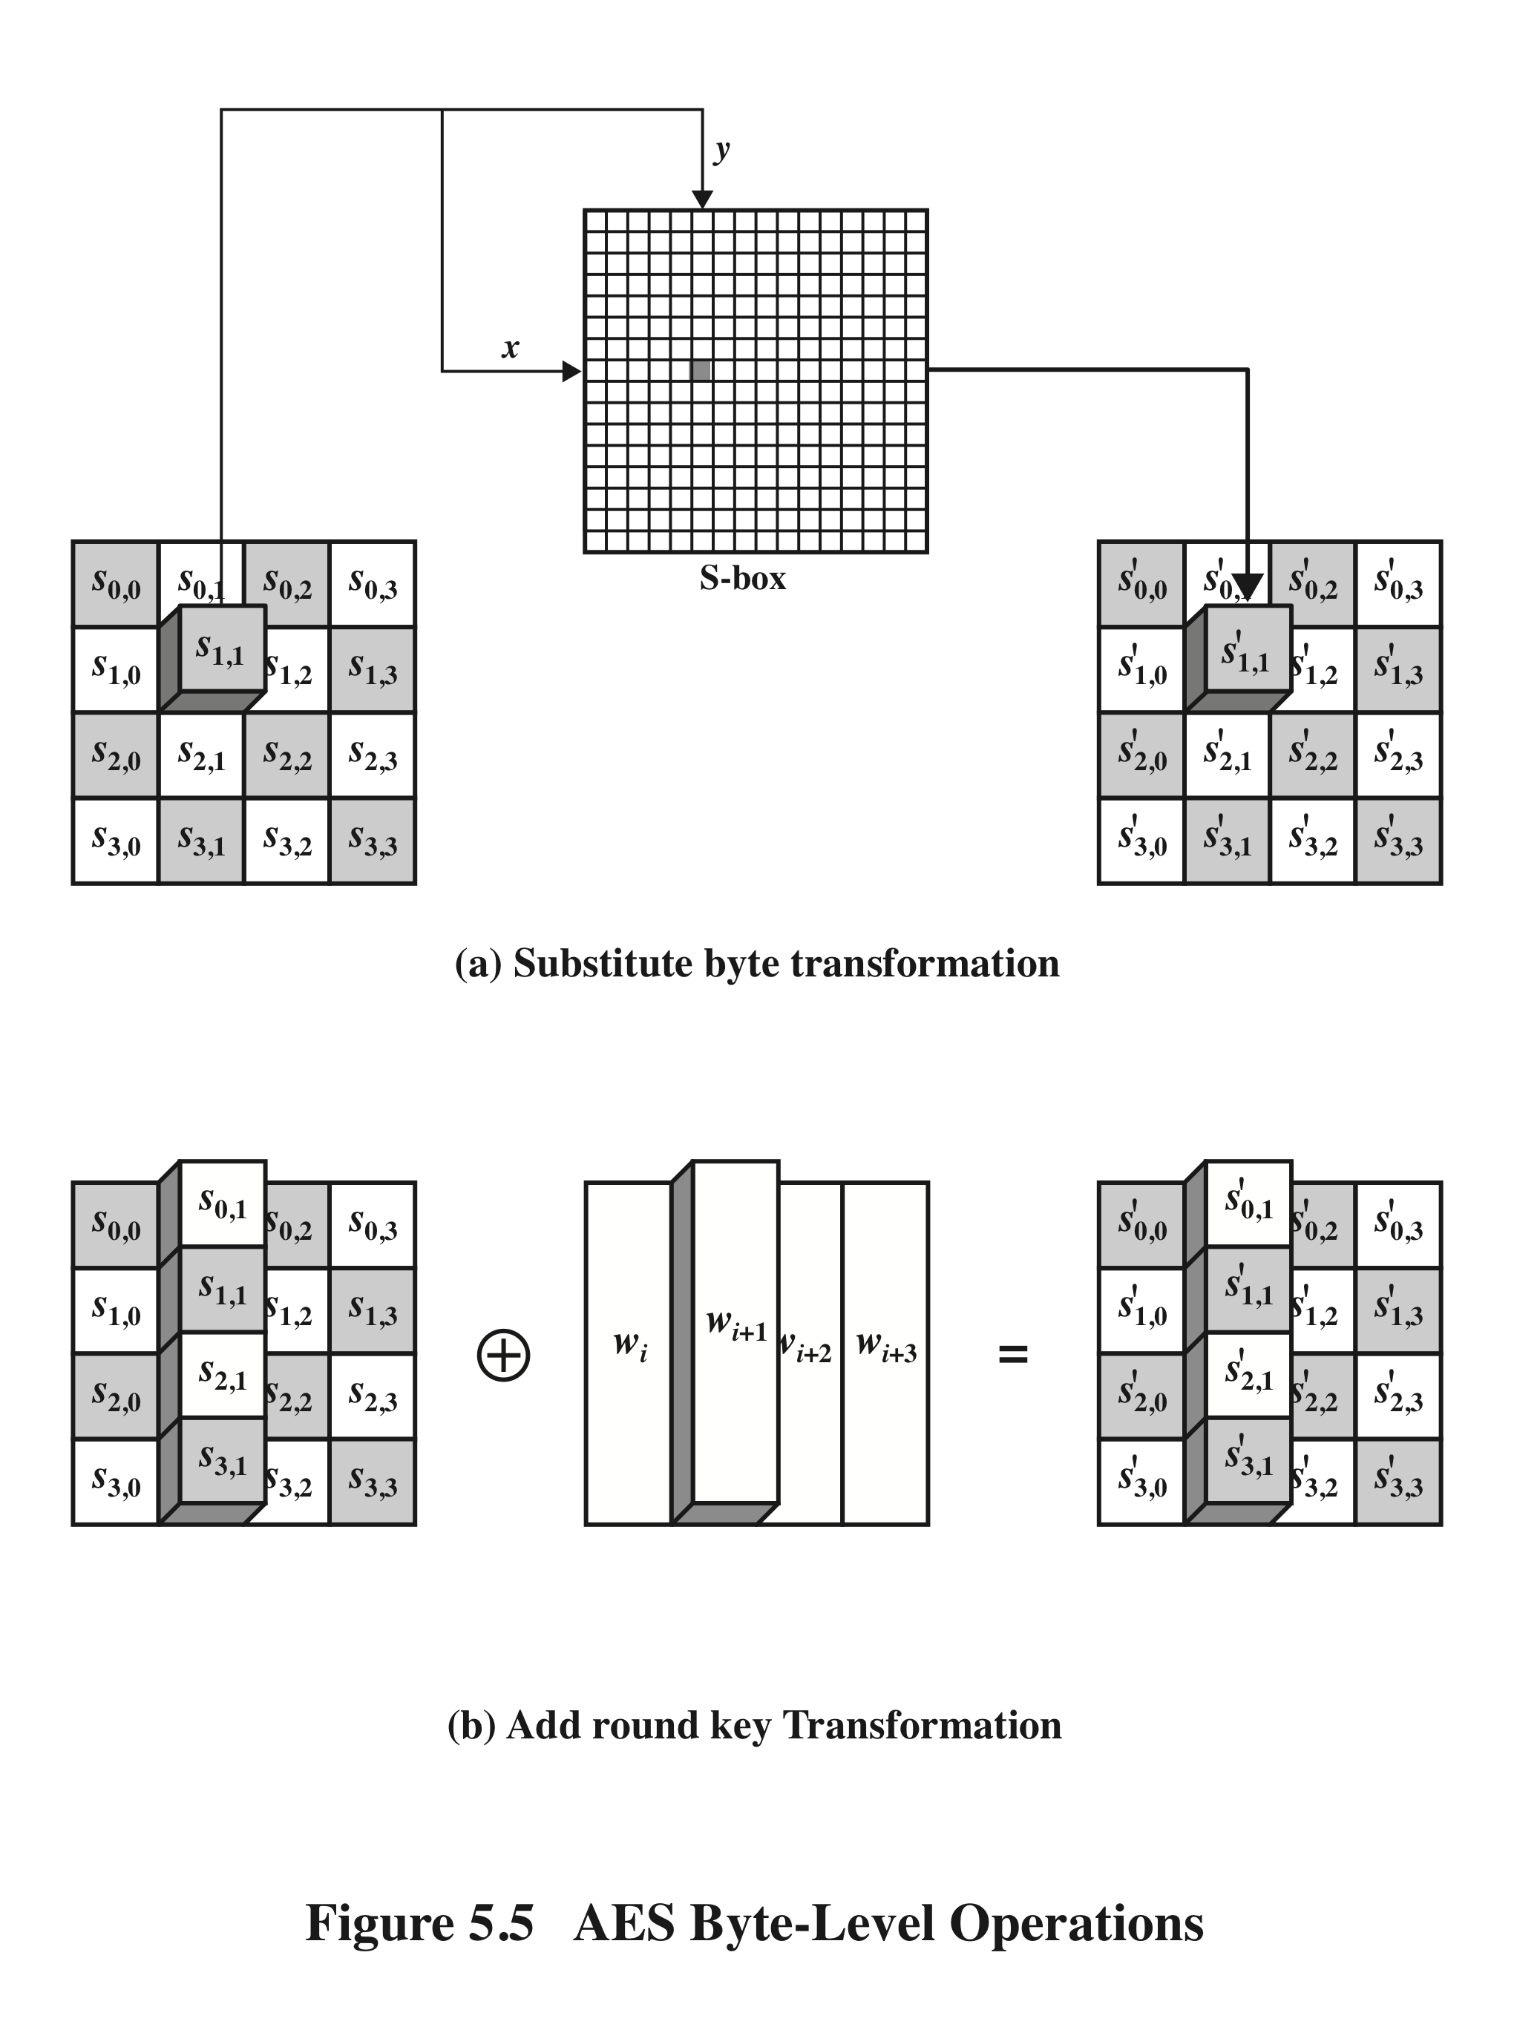
AES
Byte
Level
Operations
Notes:
The forward substitute byte transformation , called SubBytes, is a simple table lookup (Figure 5.5a).

Slide 62
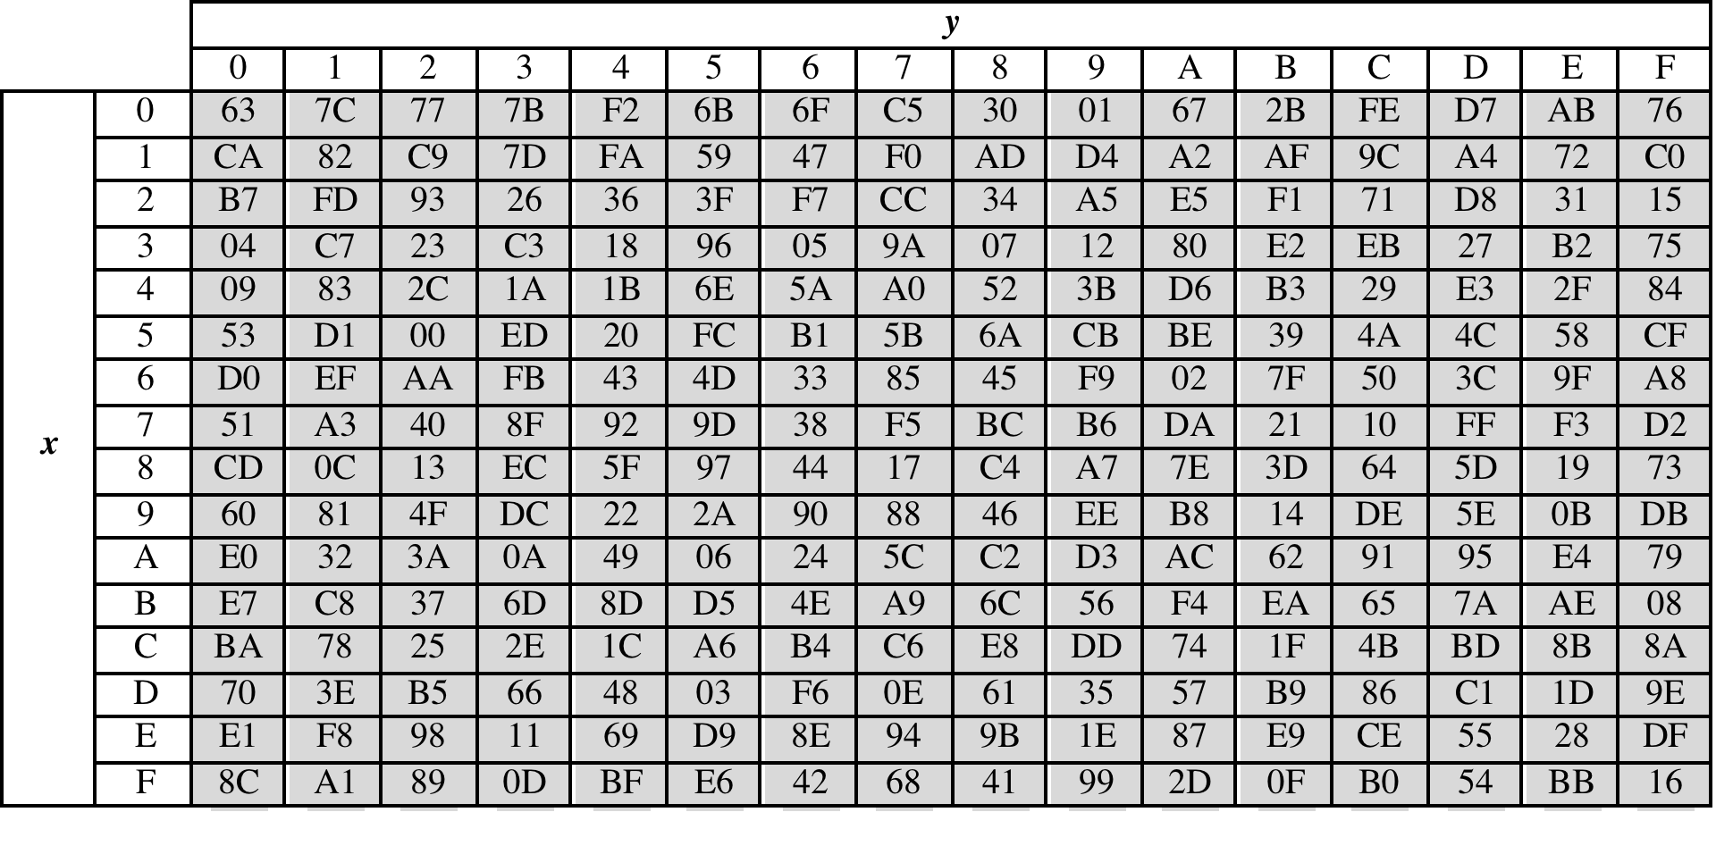
Table 5.2
(a) S-box
(Table can be found on page 139 in textbook)
Notes:
AES defines a 16 * 16 matrix of byte values, called an S-box (Table 5.2a), that contains
a permutation of all possible 256 8-bit values. Each individual byte of State
is mapped into a new byte in the following way: The leftmost 4 bits of the byte
are used as a row value and the rightmost 4 bits are used as a column value.
These row and column values serve as indexes into the S-box to select a unique
8-bit output value. For example, the hexadecimal value {95} references row 9,
column 5 of the S-box, which contains the value {2A}. Accordingly, the value {95}
is mapped into the value {2A}.

Slide 63
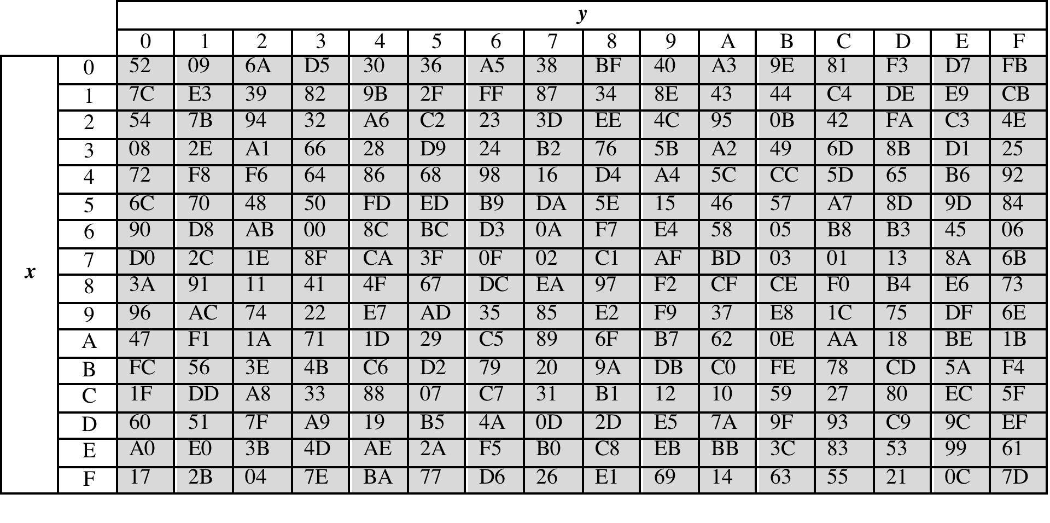
Table 5.2
(b) Inverse S-box
(Table can be found on page 139 in textbook)
Notes:
The inverse substitute byte transformation , called InvSubBytes, makes use
of the inverse S-box shown in Table 5.2b.

Slide 64
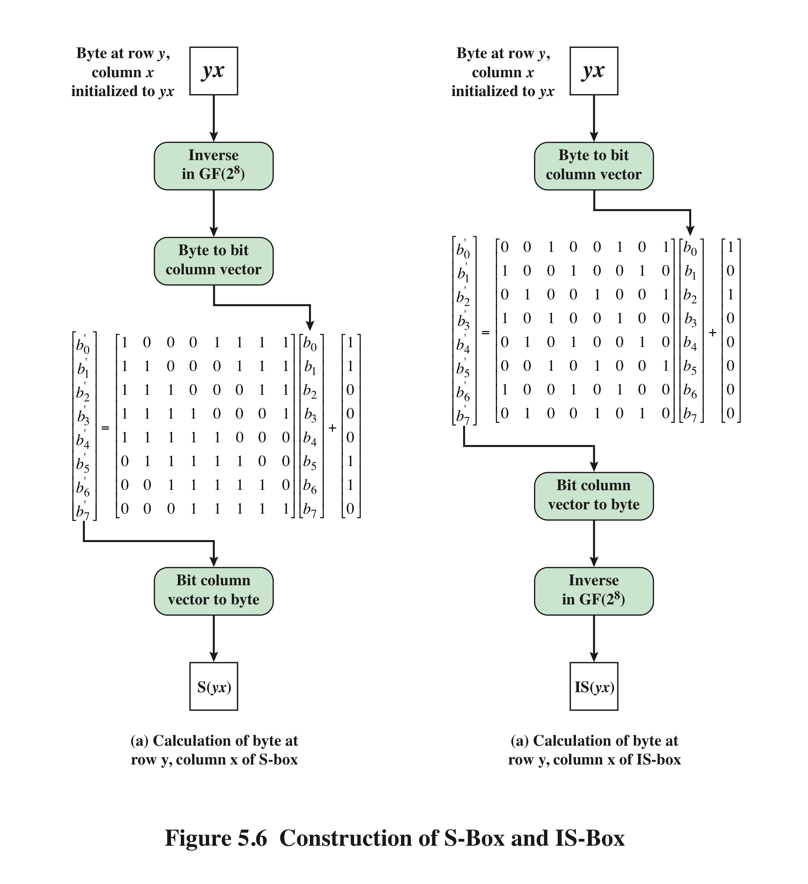
Notes:
Construction of S-Box and IS-Box

Slide 65
S-Box Rationale
The S-box is designed to be resistant to known cryptanalytic attacks
The Rijndael developers sought a design that has a low correlation between input bits and output bits and the property that the output is not a linear mathematical function of the input
The nonlinearity is due to the use of the multiplicative inverse
Notes:
The S-box is designed to be resistant to known cryptanalytic attacks.
Specifically, the Rijndael developers sought a design that has a low correlation
Between input bits and output bits and the property that the output is not a linear
mathematical function of the input [DAEM01]. The nonlinearity is due to the use
of the multiplicative inverse.

Slide 66
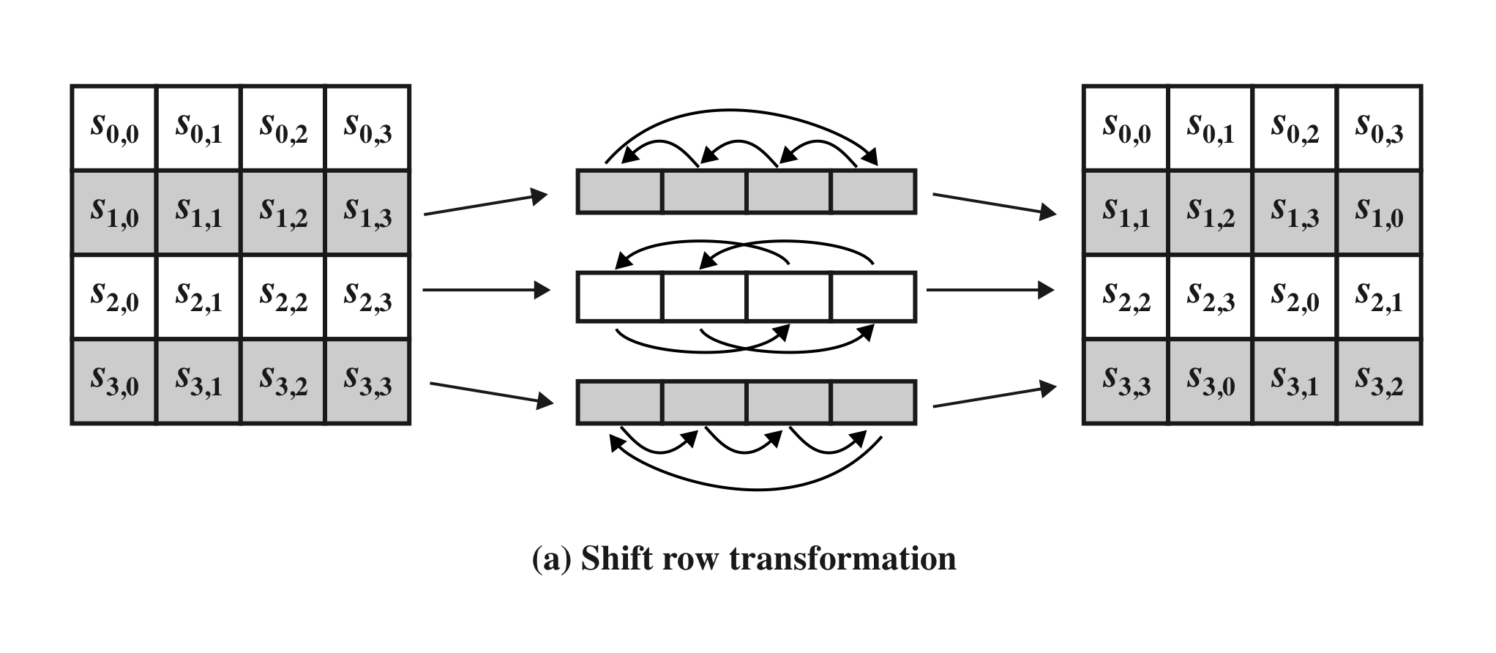
Shift Row Transformation
Figure 5.7 AES Row and Column Operations
(Figure can be found on page 144 in textbook)
Notes:
The forward shift row transformation ,
called ShiftRows, is depicted in Figure 5.7a. The first row of State is not altered. For
the second row, a 1-byte circular left shift is performed. For the third row, a 2-byte
circular left shift is performed. For the fourth row, a 3-byte circular left shift is performed.
The following is an example of ShiftRows.
The inverse shift row transformation , called InvShiftRows, performs the circular
shifts in the opposite direction for each of the last three rows, with a 1-byte
circular right shift for the second row, and so on.

Slide 67
Shift Row Rationale
More substantial than it may first appear
The State, as well as the cipher input and output, is treated as an array of four 4-byte columns
On encryption, the first 4 bytes of the plaintext are copied to the first column of State, and so on
The round key is applied to State column by column
  Thus, a row shift moves an individual byte from one column to another, which is a linear distance of a multiple of 4 bytes
Transformation ensures that the 4 bytes of one column are spread out to four different columns
Notes:
The shift row transformation is more substantial than it may first
appear. This is because the State , as well as the cipher input and output, is
treated as an array of four 4-byte columns. Thus, on encryption, the first 4 bytes
of the plaintext are copied to the first column of State , and so on. Furthermore,
as will be seen, the round key is applied to State column by column. Thus, a row
shift moves an individual byte from one column to another, which is a linear
distance of a multiple of 4 bytes. Also note that the transformation ensures that
the 4 bytes of one column are spread out to four different columns. Figure 5.4
illustrates the effect.

Slide 68
MixColumn Transformation
Figure 5.7 AES Row and Column Operations
(Figure can be found on page 144 in textbook)
Notes:
The forward mix column transformation,
called MixColumns, operates on each column individually. Each byte of a column
is mapped into a new value that is a function of all four bytes in that column. The
transformation can be defined by the following matrix multiplication on State
(Figure 5.7b)
Each element in the product matrix is the sum of products of elements of one row
and one column. In this case, the individual additions and multiplications are
performed in GF(2⁸ ).

Slide 69
Mix Columns Rationale
Coefficients of a matrix based on a linear code with maximal distance between code words ensures a good mixing among the bytes of each column
The mix column transformation combined with the shift row transformation ensures that after a few rounds all output bits depend on all input bits
Notes:
The coefficients of the matrix in Equation (5.3) are based on a linear
code with maximal distance between code words, which ensures a good mixing
among the bytes of each column. The mix column transformation combined with
the shift row transformation ensures that after a few rounds all output bits depend
on all input bits. See [DAEM99] for a discussion.
In addition, the choice of coefficients in MixColumns, which are all {01}, { 02},
or { 03}, was influenced by implementation considerations. As was discussed, multiplication
by these coefficients involves at most a shift and an XOR. The coefficients
in InvMixColumns are more formidable to implement. However, encryption was
deemed more important than decryption for two reasons:
1. For the CFB and OFB cipher modes (Figures 6.5 and 6.6; described in Chapter 6),
only encryption is used.
2. As with any block cipher, AES can be used to construct a message authentication
code (Chapter 12), and for this, only encryption is used.

Slide 70
AddRoundKey Transformation
The 128 bits of State are bitwise XORed with the 128 bits of the round key
Operation is viewed as a columnwise operation between the 4 bytes of a State column and one word of the round key
  Can also be viewed as a byte-level operation
Rationale:
Is as simple as possible and affects every bit of State
The complexity of the round key expansion plus the complexity of the other stages of AES ensure security
Notes:
In the forward add round key transformation ,
called AddRoundKey, the 128 bits of State are bitwise XORed with the 128
bits of the round key. As shown in Figure 5.5b, the operation is viewed as a columnwise
operation between the 4 bytes of a State column and one word of the round
key; it can also be viewed as a byte-level operation.
The add round key transformation is as simple as possible and affects
every bit of State . The complexity of the round key expansion, plus the complexity
of the other stages of AES, ensure security.

Slide 71
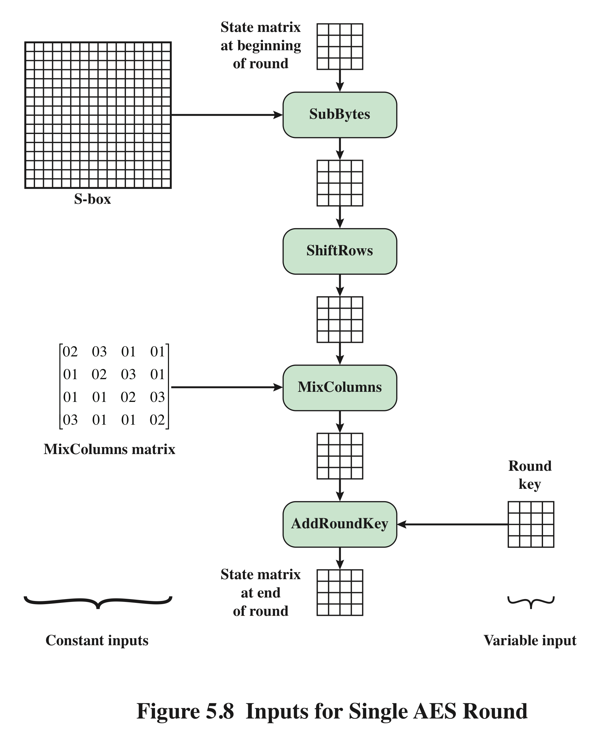
Inputs for
Single
AES
Round
Notes:
Figure 5.8 is another view of a single round of AES, emphasizing the mechanisms
and inputs of each transformation.

Slide 72
AES Key Expansion
Takes as input a four-word (16 byte) key and produces a linear array of 44 words (176) bytes
  This is sufficient to provide a four-word round key for the initial AddRoundKey stage and each of the 10 rounds of the cipher
Key is copied into the first four words of the expanded key
  The remainder of the expanded key is filled in four words at a time
Each added word w[i] depends on the immediately preceding word, w[i – 1], and the word four positions back, w[i – 4]
  In three out of four cases a simple XOR is used
  For a word whose position in the w array is a multiple of 4, a more complex function is used
Notes:
The AES key expansion algorithm takes as input a four-word (16-byte) key and
produces a linear array of 44 words (176 bytes). This is sufficient to provide a four word
round key for the initial AddRoundKey stage and each of the 10 rounds of the
cipher. The pseudocode on the next page describes the expansion.
The key is copied into the first four words of the expanded key. The remainder
of the expanded key is filled in four words at a time. Each added word w [i]
depends on the immediately preceding word, w [i - 1], and the word four positions
back, w [i - 4]. In three out of four cases, a simple XOR is used. For a word whose
position in the w array is a multiple of 4, a more complex function is used.

Slide 73
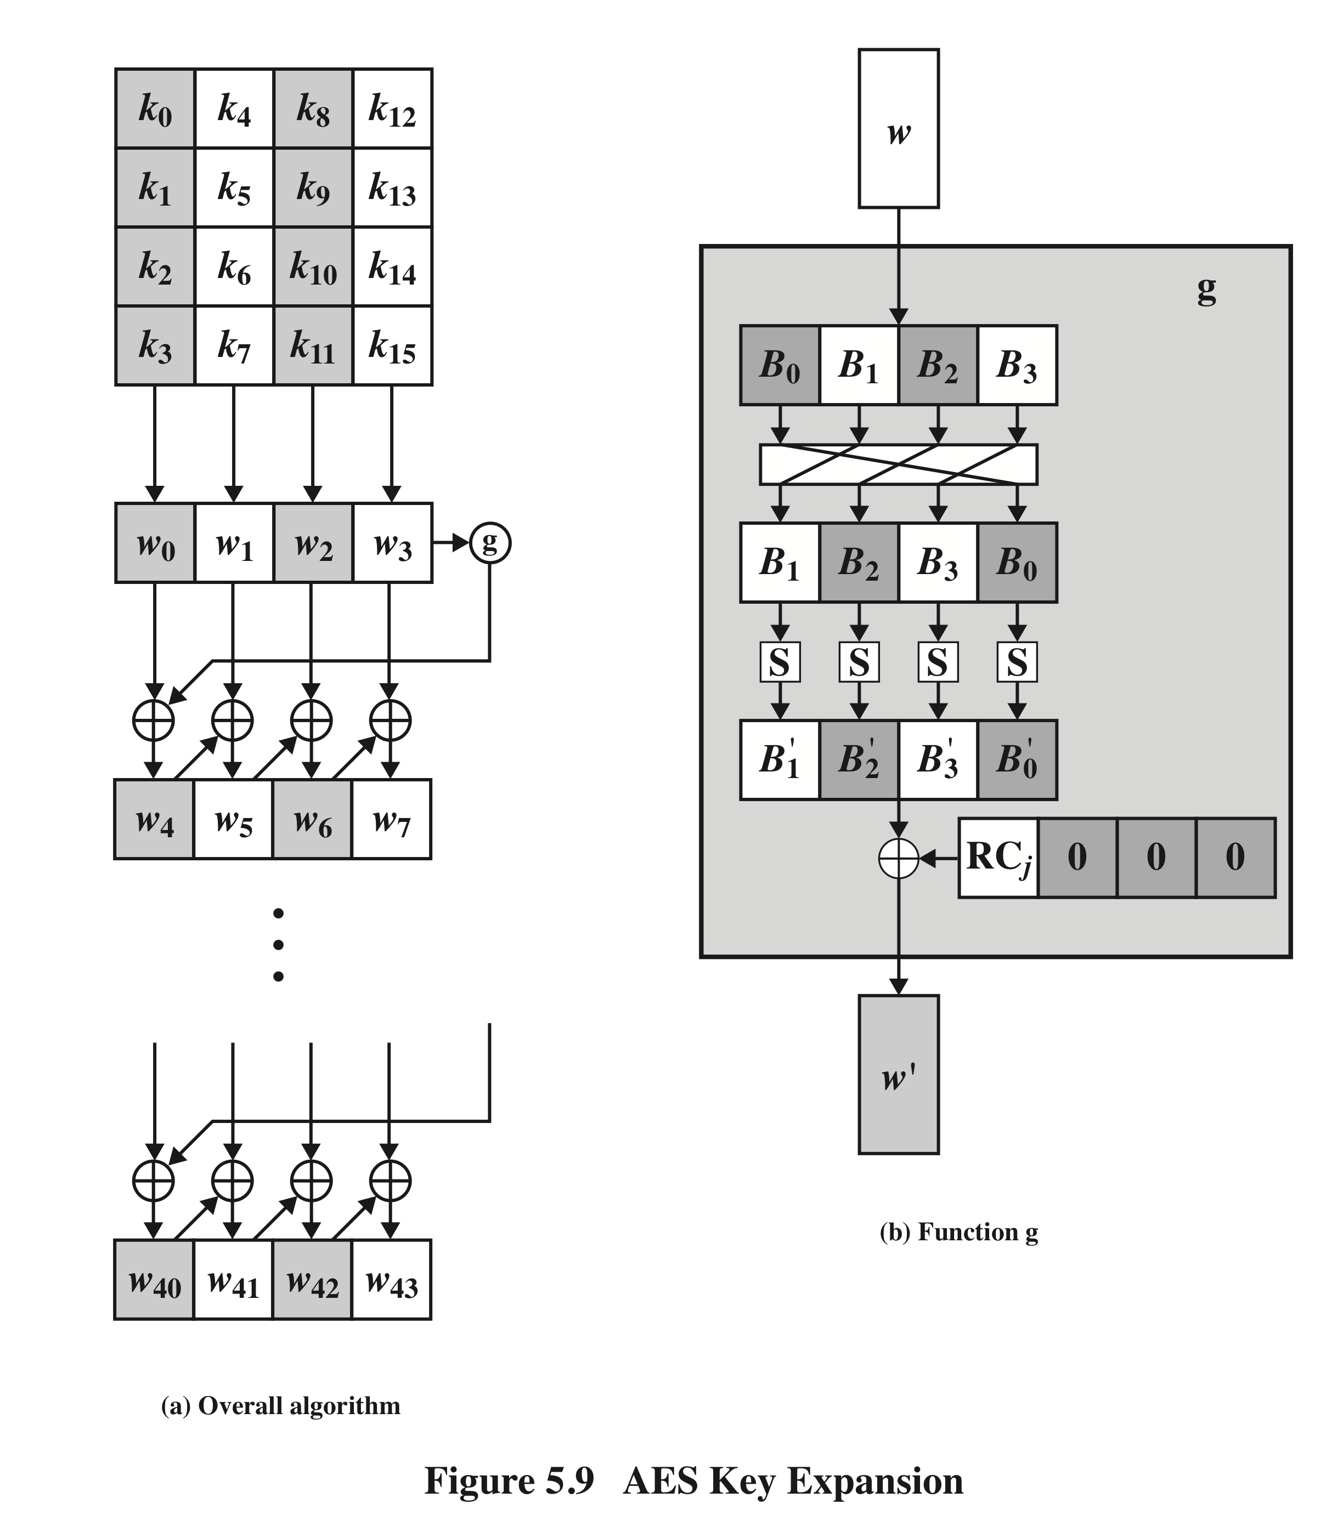
AES
Key Expansion
Notes:
Figure 5.9 illustrates the generation of the expanded key, using the symbol g to represent that
complex function.

Slide 74
Key Expansion Rationale
The Rijndael developers designed the expansion key algorithm to be resistant to known cryptanalytic attacks
Inclusion of a round-dependent round constant eliminates the symmetry between the ways in which round keys are generated in different rounds
The specific criteria that were used are:
Knowledge of a part of the cipher key or round key does not enable calculation of many other round-key bits
An invertible transformation
Speed on a wide range of processors
Usage of round constants to eliminate symmetries
Diffusion of cipher key differences into the round keys
Enough nonlinearity to prohibit the full determination of round key differences from cipher key differences only
Simplicity of description
Notes:
The Rijndael developers designed the expansion key algorithm to be resistant to
known cryptanalytic attacks. The inclusion of a round-dependent round constant
eliminates the symmetry, or similarity, between the ways in which round keys are
generated in different rounds. The specific criteria that were used are [DAEM99]
• Knowledge of a part of the cipher key or round key does not enable calculation
of many other round-key bits.
• An invertible transformation [i.e., knowledge of any Nk consecutive words of
the expanded key enables regeneration of the entire expanded key (Nk = key
size in words)].
• Speed on a wide range of processors.
• Usage of round constants to eliminate symmetries.
• Diffusion of cipher key differences into the round keys; that is, each key bit
affects many round key bits.
• Enough nonlinearity to prohibit the full determination of round key differences
from cipher key differences only.
• Simplicity of description.
he authors do not quantify the first point on the preceding list, but the idea
is that if you know less than Nk consecutive words of either the cipher key or one of
the round keys, then it is difficult to reconstruct the remaining unknown bits. The
fewer bits one knows, the more difficult it is to do the reconstruction or to determine
other bits in the key expansion.

Slide 75
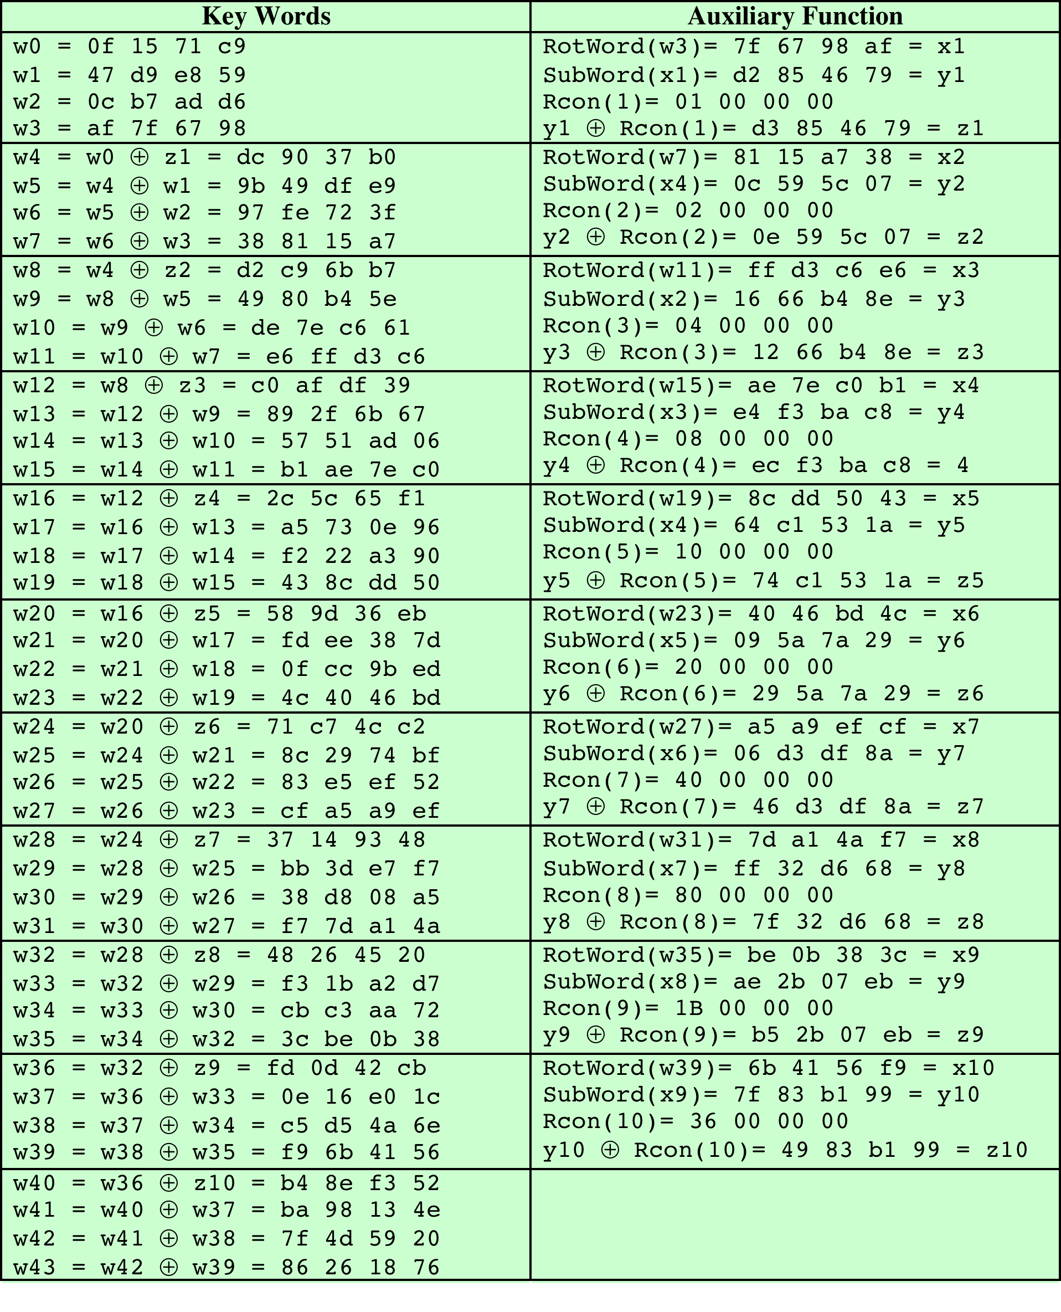
Table 5.3
AES Example Key Expansion
(Table is located on page 151
in textbook)
Notes:
Table 5.3 shows the expansion of the 16-byte key into 10 round keys. As previously
explained, this process is performed word by word, with each four-byte word occupying
one column of the word round-key matrix. The left-hand column shows
the four round-key words generated for each round. The right-hand column shows
the steps used to generate the auxiliary word used in key expansion. We begin, of
course, with the key itself serving as the round key for round 0.

Slide 76
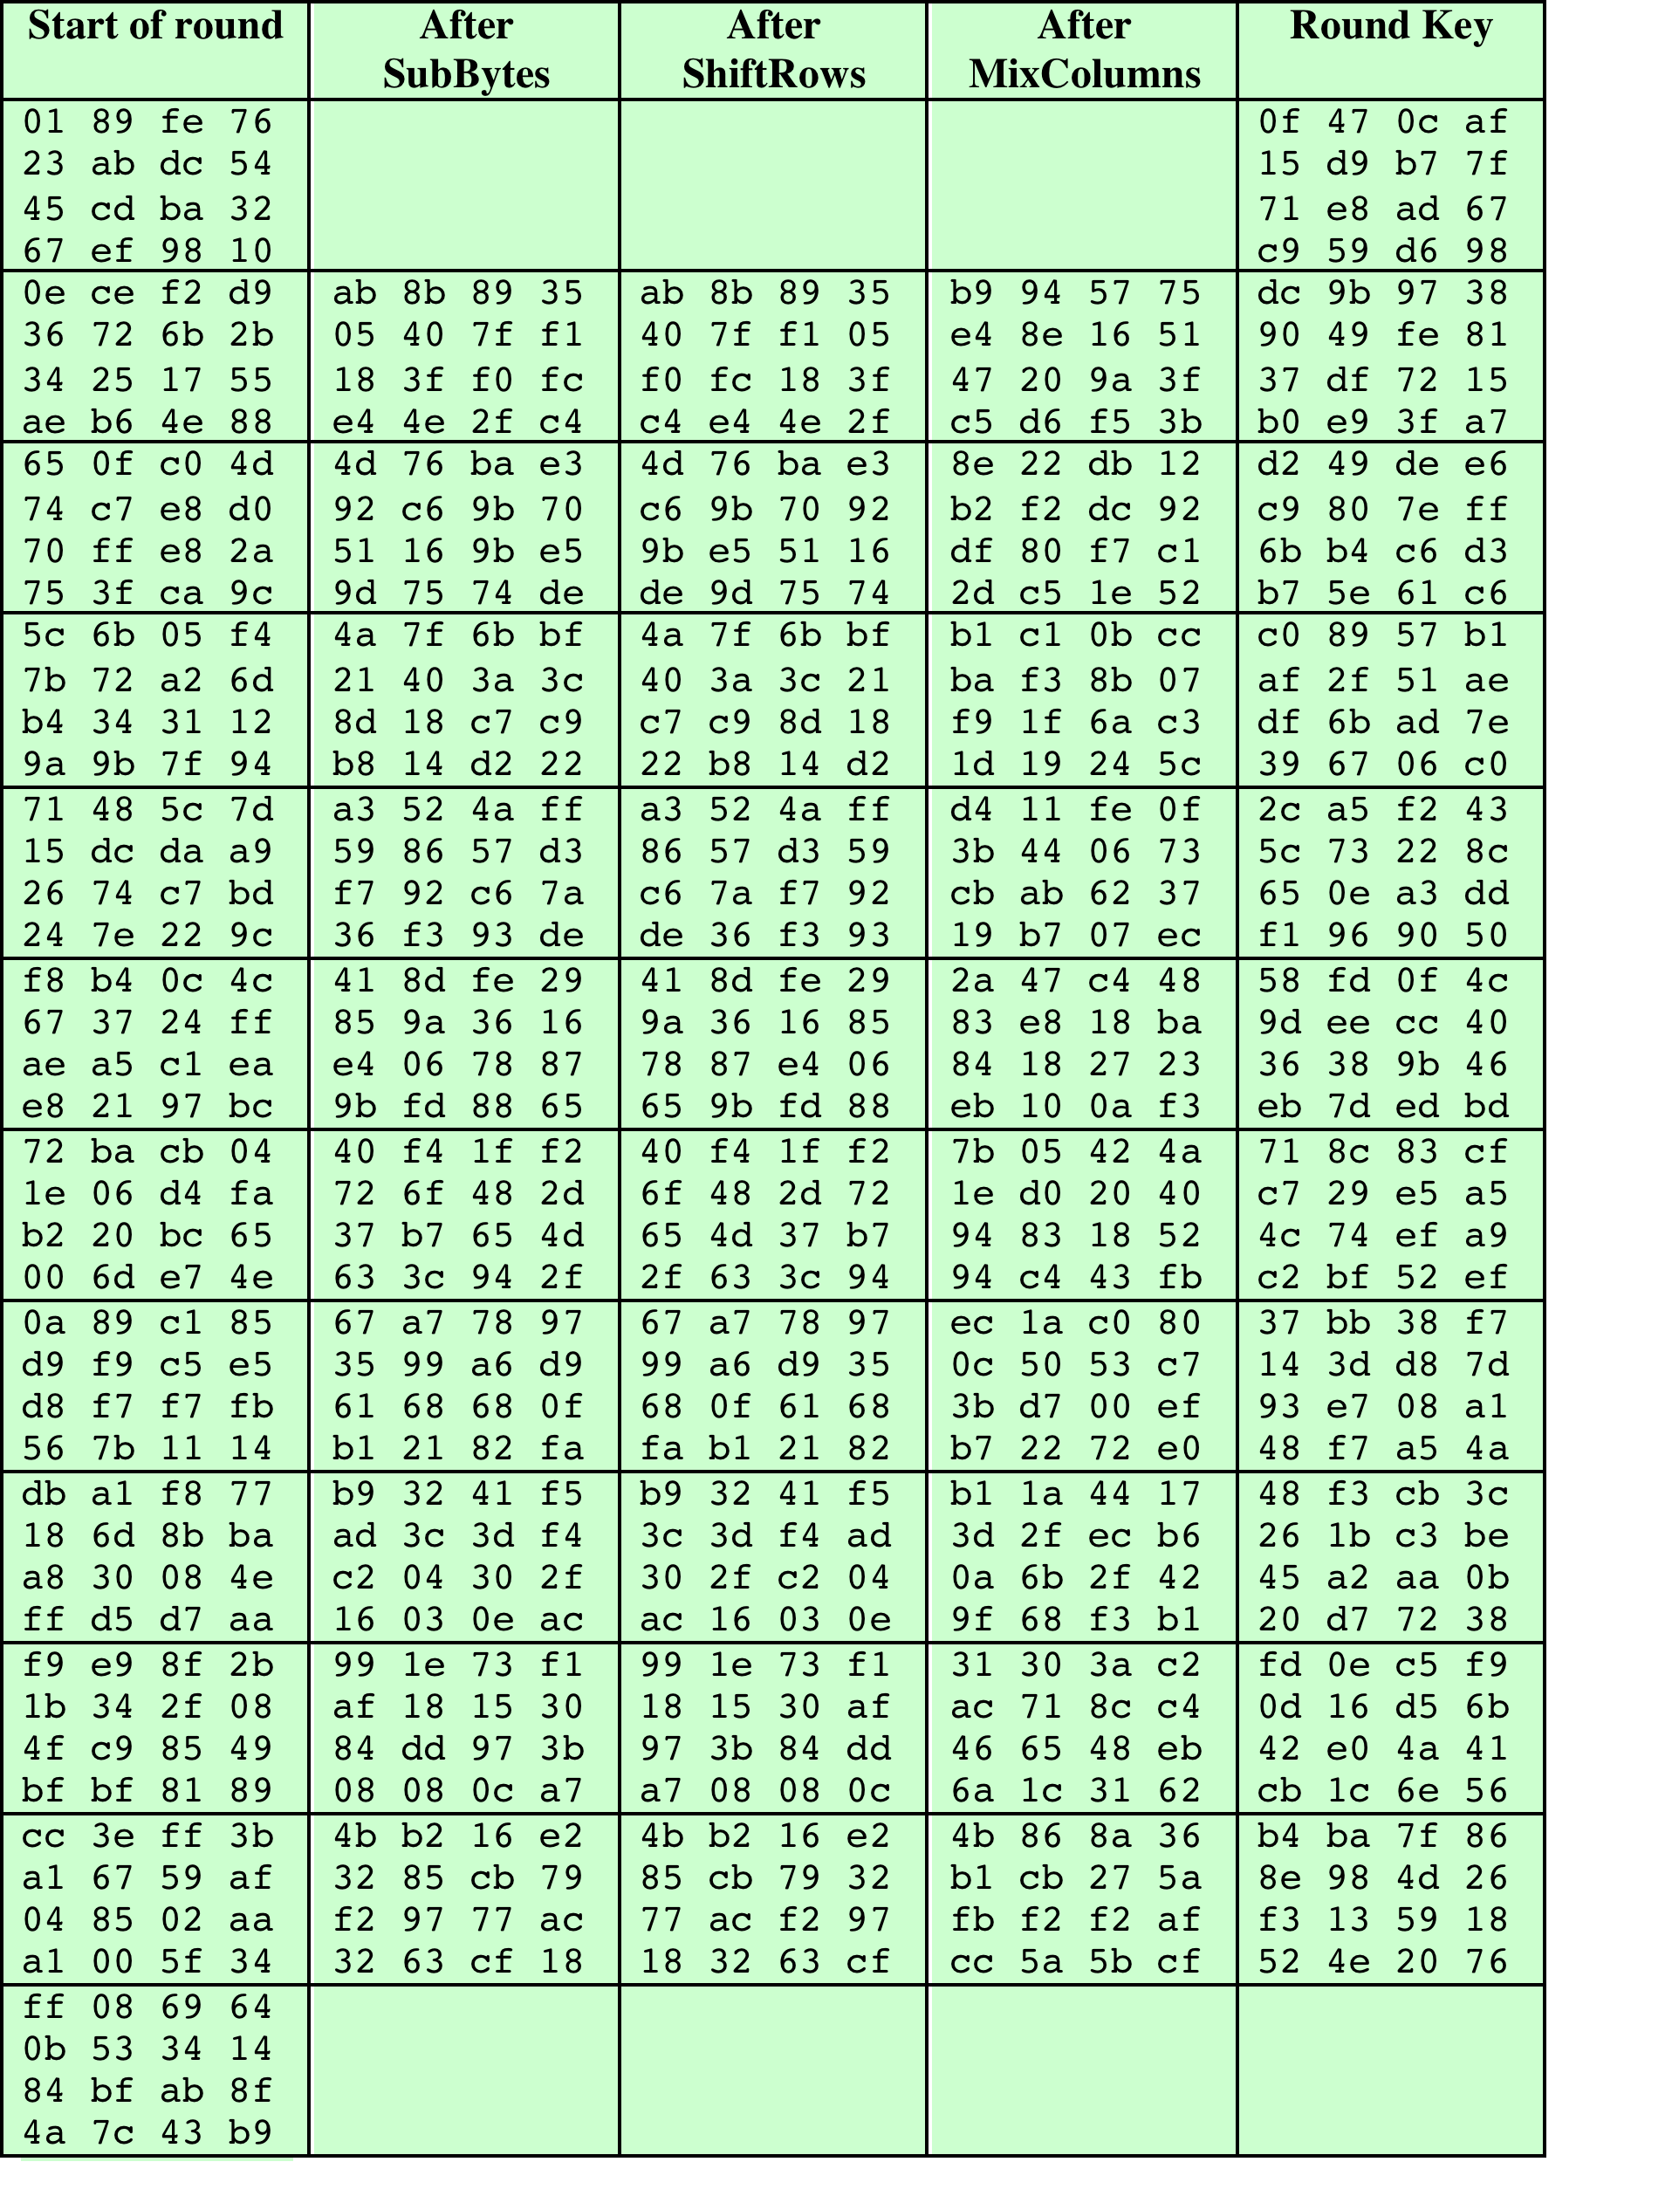
Table 5.4
AES
Example
(Table is located on page 153
in textbook)
Notes:
Next, Table 5.4 shows the progression of State through the AES encryption
process. The first column shows the value of State at the start of a round. For the
first row, State is just the matrix arrangement of the plaintext. The second, third, and
fourth columns show the value of State for that round after the SubBytes, ShiftRows,
and MixColumns transformations, respectively. The fifth column shows the round
key. You can verify that these round keys equate with those shown in Table 5.3. The
first column shows the value of State resulting from the bitwise XOR of State after
the preceding MixColumns with the round key for the preceding round.

Slide 77
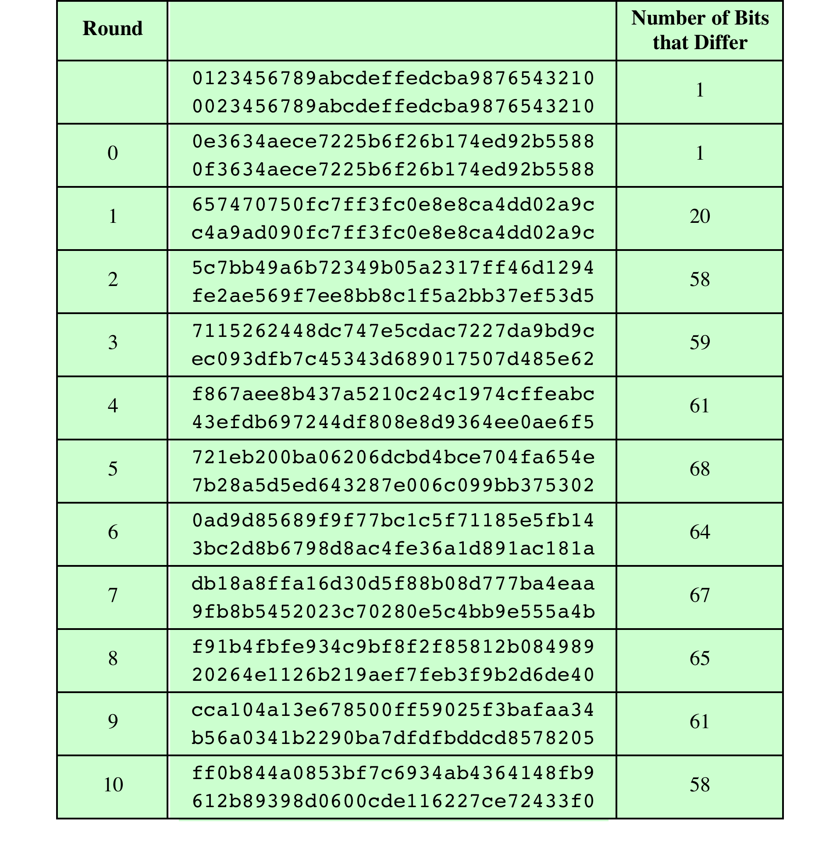
Table 5.5
Avalanche Effect
in AES: Change in Plaintext
(Table is located on page 154
in textbook)
Notes:
If a small change in the key or plaintext were to produce a corresponding small
change in the ciphertext, this might be used to effectively reduce the size of the
plaintext (or key) space to be searched. What is desired is the avalanche effect, in
which a small change in plaintext or key produces a large change in the ciphertext.
Using the example from Table 5.4, Table 5.5 shows the result when the
eighth bit of the plaintext is changed. The second column of the table shows the
value of the State matrix at the end of each round for the two plaintexts. Note
that after just one round, 20 bits of the State vector differ. After two rounds,
close to half the bits differ. This magnitude of difference propagates through
the remaining rounds. A bit difference in approximately half the positions in the
most desirable outcome. Clearly, if almost all the bits are changed, this would be
logically equivalent to almost none of the bits being changed. Put another way, if
we select two plaintexts at random, we would expect the two plaintexts to differ
in about half of the bit positions and the two ciphertexts to also differ in about
half the positions.

Slide 78
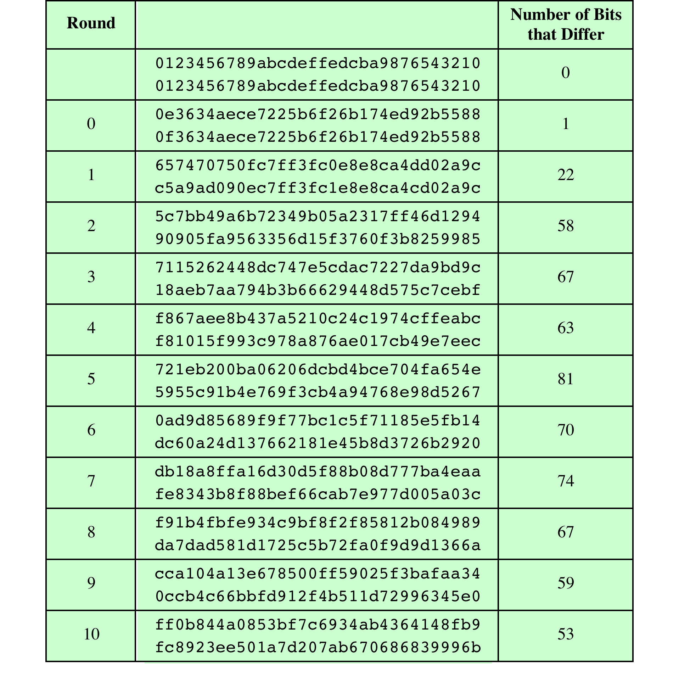
Table 5.6
Avalanche Effect
in AES: Change
in Key
(Table is located on page 155
in textbook)
Notes:
Table 5.6 shows the change in State matrix values when the same plaintext is
used and the two keys differ in the eighth bit. That is, for the second case, the key is
0e1571c947d9e8590cb7add6af7f6798. Again, one round produces a significant
change, and the magnitude of change after all subsequent rounds is roughly half
the bits. Thus, based on this example, AES exhibits a very strong avalanche effect.
Note that this avalanche effect is stronger than that for DES (Table 3.2),
which requires three rounds to reach a point at which approximately half the bits
are changed, both for a bit change in the plaintext and a bit change in the key.

Slide 79
Equivalent Inverse Cipher
AES decryption cipher is not identical to the encryption cipher
  The sequence of transformations differs although the form of the key schedules is the same
  Has the disadvantage that two separate software or firmware modules are needed for applications that require both encryption and decryption
Two separate changes are needed to bring the decryption structure in line with the encryption structure
The first two stages of the decryption round need to be interchanged
The second two stages of the decryption round need to be interchanged
Notes:
As was mentioned, the AES decryption cipher is not identical to the encryption
cipher (Figure 5.3). That is, the sequence of transformations for decryption differs
from that for encryption, although the form of the key schedules for encryption
and decryption is the same. This has the disadvantage that two separate software
or firmware modules are needed for applications that require both encryption and
decryption. There is, however, an equivalent version of the decryption algorithm
that has the same structure as the encryption algorithm. The equivalent version has
the same sequence of transformations as the encryption algorithm (with transformations
replaced by their inverses). To achieve this equivalence, a change in key
schedule is needed.
Two separate changes are needed to bring the decryption structure in line
with the encryption structure. As illustrated in Figure 5.3, an encryption round has
the structure SubBytes, ShiftRows, MixColumns, AddRoundKey. The standard
decryption round has the structure InvShiftRows, InvSubBytes, AddRoundKey,
InvMixColumns. Thus, the first two stages of the decryption round need to
be interchanged, and the second two stages of the decryption round need to be
interchanged.

Slide 80
Interchanging
InvShiftRows and InvSubBytes
InvShiftRows affects the sequence of bytes in State but does not alter byte contents and does not depend on byte contents to perform its transformation
InvSubBytes affects the contents of bytes in State but does not alter byte sequence and does not depend on byte sequence to perform its transformation
Thus, these two operations commute and can be interchanged
Notes:
InvShiftRows affects the
sequence of bytes in State but does not alter byte contents and does not depend
on byte contents to perform its transformation. InvSubBytes affects the contents
of bytes in State but does not alter byte sequence and does not depend on byte
sequence to perform its transformation. Thus, these two operations commute and
can be interchanged.

Slide 81
Interchanging
AddRoundKey and InvMixColumns
The transformations AddRoundKey and InvMixColumns do not alter the sequence of bytes in State
If we view the key as a sequence of words, then both AddRoundKey and InvMixColumns operate on State one column at a time
These two operations are linear with respect to the column input
Notes:
The transformations
AddRoundKey and InvMixColumns do not alter the sequence of bytes in State . If we
view the key as a sequence of words, then both AddRoundKey and InvMixColumns
operate on State one column at a time. These two operations are linear with respect
to the column input.

Slide 82
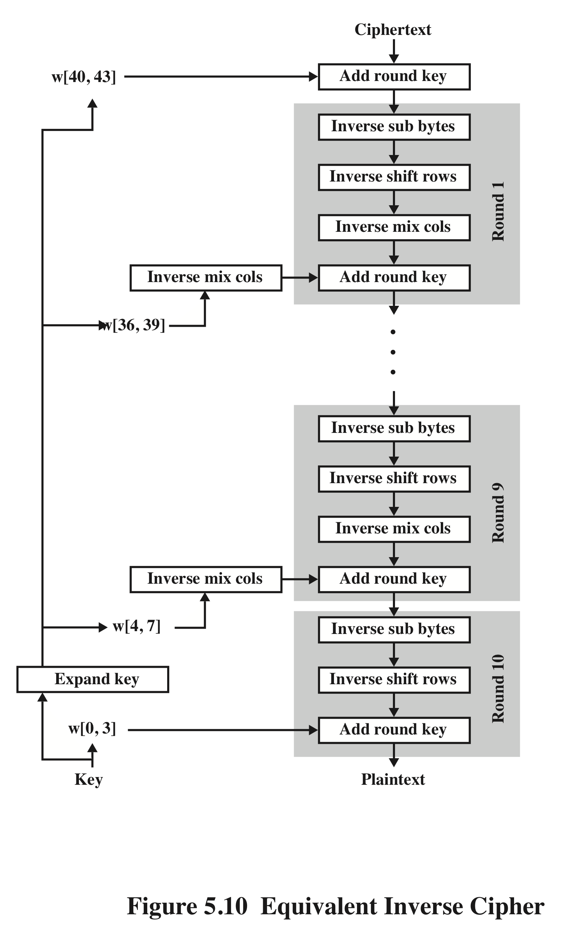
Equivalent Inverse
Cipher
Notes:
Figure 5.10 illustrates the equivalent decryption algorithm.

Slide 83
Implementation Aspects
AES can be implemented very efficiently on an 8-bit processor
AddRoundKey is a bytewise XOR operation
ShiftRows is a simple byte-shifting operation
SubBytes operates at the byte level and only requires a table of 256 bytes
MixColumns requires matrix multiplication in the field GF(2⁸), which means that all operations are carried out on bytes
Notes:
The Rijndael proposal [DAEM99] provides some suggestions for efficient implementation
on 8-bit processors, typical for current smart cards, and on 32-bit processors,
typical for PCs.
AES can be implemented very efficiently on an 8-bit processor.
AddRoundKey is a bytewise XOR operation. ShiftRows is a simple byteshifting
operation. SubBytes operates at the byte level and only requires a table of
256 bytes.
The transformation MixColumns requires matrix multiplication in the field
GF(28 ), which means that all operations are carried out on bytes. MixColumns only
requires multiplication by {02} and {03}, which, as we have seen, involved simple
shifts, conditional XORs, and XORs. This can be implemented in a more efficient
way that eliminates the shifts and conditional XORs.

Slide 84
Implementation Aspects
Can efficiently implement on a 32-bit processor
  Redefine steps to use 32-bit words
  Can precompute 4 tables of 256-words
  Then each column in each round can be computed using 4 table lookups + 4 XORs
  At a cost of 4Kb to store tables
Designers believe this very efficient implementation was a key factor in its selection as the AES cipher
Notes:
The implementation described in the preceding subsection uses
only 8-bit operations. For a 32-bit processor, a more efficient implementation can
be achieved if operations are defined on 32-bit words. To show this, we first define
the four transformations of a round in algebraic form.
The developers of Rijndael believe that this compact, efficient implementation
was probably one of the most important factors in the selection of Rijndael for AES.

Slide 85
AES Rijndael Encryption Cipher Overview
Youtube Example

Slide 86
AES Rijndael Cipher - Visualization
Thanks to Abin Alichin and Youtube
    Example
Scholartica Channel – some details and examples
    https://www.youtube.com/watch?v=nL1ApwEXrz0

Slide 87
Summary
AES transformation functions
  Substitute bytes
  ShiftRows
  MixColumns
  AddRoundKey
  AES implementation
  Equivalent inverse cipher
  Implementation aspects
Finite field arithmetic
AES structure
  General structure
  Detailed structure
AES key expansion
  Key expansion algorithm
  Rationale
Notes:
Chapter 5 summary.

